Slide 1
Election Inspector
(Poll Worker)
Training
Town of Oregon
January 29, 2026

Slide 2
Election Inspector Training Agenda
Introductions
Training Requirements/Oath of Office
Election Day Roles
Back to Basics: The Photo ID Law
Updates to Badger Books
Review of DS200s/Automark/Public Test
Communication/Availability
Questions?
Thank you!

Slide 3
Introductions

Slide 4

Thank you for your service and congratulations on your appointment!
Being a poll worker is a difficult job, but we know you are up to the challenge.
There are many procedures to understand and the rules for elections in Wisconsin are always changing, which makes your role even more difficult.
We appreciate your dedication to serving voters and facilitating the democratic process here in Wisconsin.

Slide 5
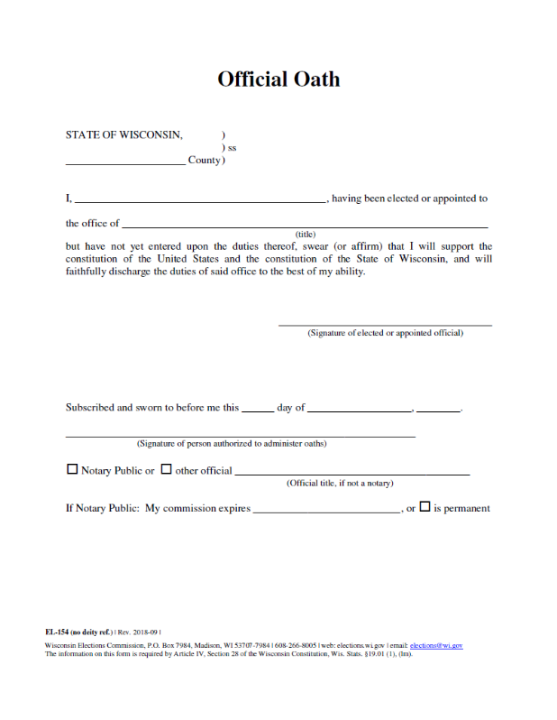
Training Requirements and Official Oath
Town Board appoints election officials at the end of odd- numbered years for the proceeding two-year term. (Current term 1/1/26-12/31/27)
Official Oath is for the two-year term.
Poll workers must complete training at least once every two years.
Poll workers should be familiar with the duties detailed in the Election Day Manual.
Poll workers should be familiar with all voting equipment used at the polling place, including the accessible voting equipment.
Poll workers can serve within the county they reside.
Poll workers are entitled to compensation. You must complete and return the necessary documents.
Poll workers may be appointed from a party list, but job is to ensure voting goes smoothly on Election Day and all eligible voters can cast a ballot.
Wisconsin Elections Commission General Poll Worker Training Videos are available here
https://vimeo.com/showcase/9655210

Slide 6
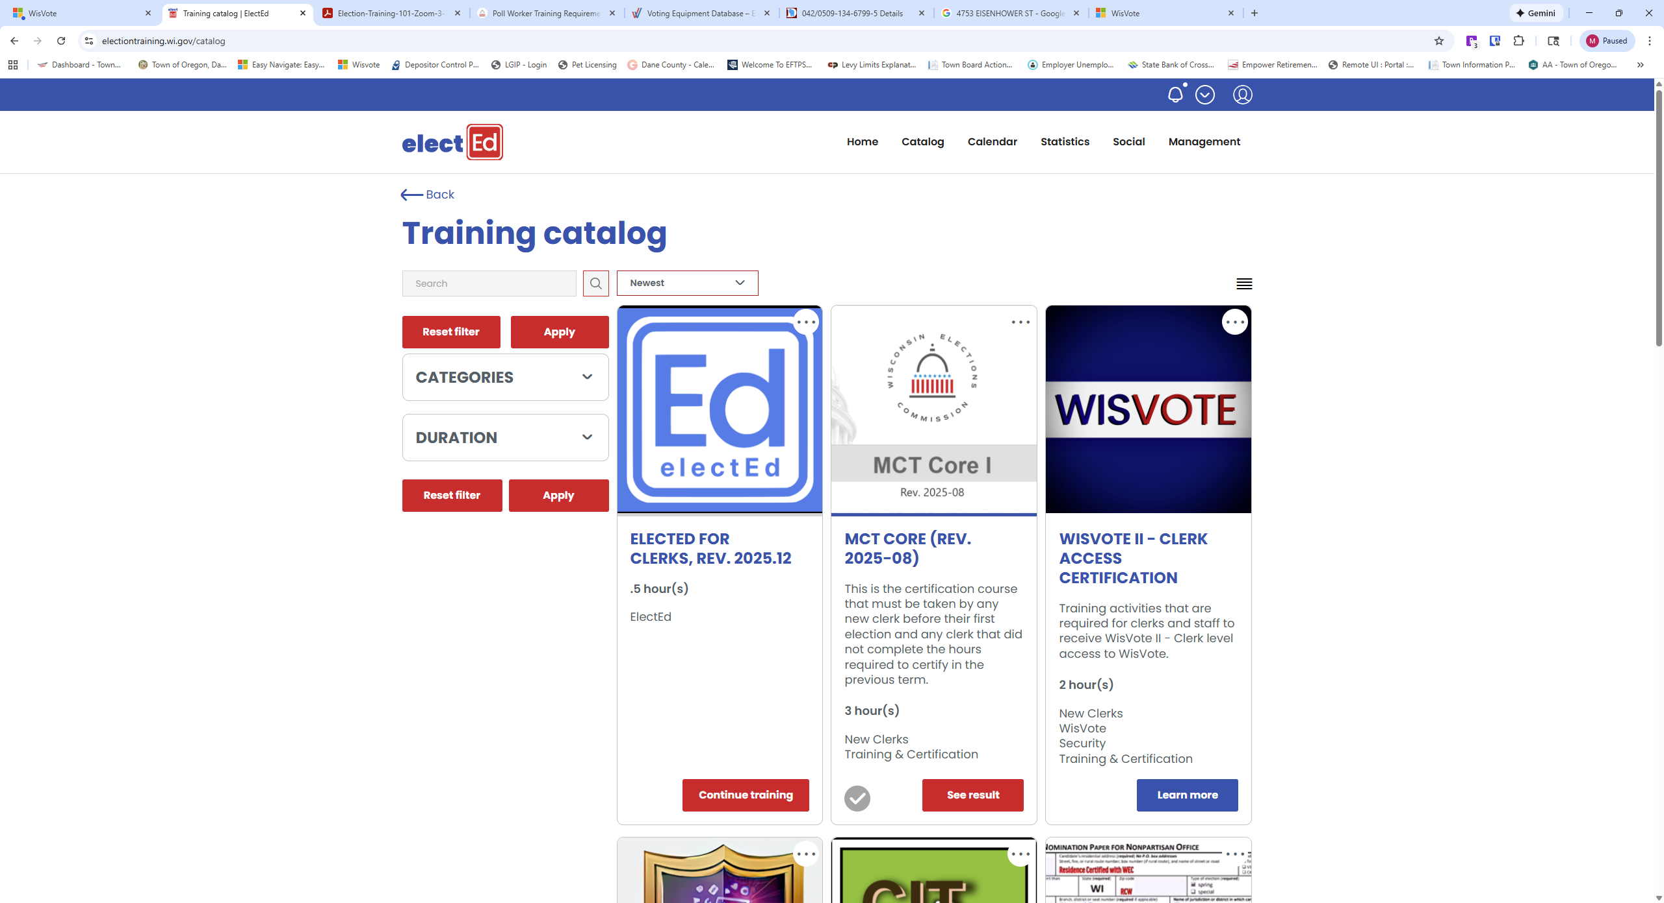
ElectEd
Election Inspectors can take online poll worker training in ElectEd
(check with Jennifer or Stephanie for access).

Slide 7

Poll Worker Conduct
No electioneering at the polling place, which is defined as any activity intended to influence voter’s ballot choices.
Attire – no politically-themed attire or materials/clothing/buttons supporting a candidate, political party or ballot initiative.
Conversation – no conversations about ballot candidates, political platforms of candidates, incumbency information or opinions on ballot initiatives such as referenda.
Other political conversations: Avoid other political topics of conversation that could violate electioneering rules and make voters uncomfortable.
Literature: polling places should not have any literature (signs, flyers, posters, newspapers, etc.) that could potentially influence voter’s ballot choices. Those materials should be removed or covered up during voting hours.

Slide 8
Election Day Roles
Badger Book – Voter Check-In; Voter Registration; Disperse Voter number.
Ballot Table – Collect Voter Number; Distribute Ballots; Instruct Voters.
Machine – Monitor ballots being placed into DS200 by voters.
Absentee Ballots – Record absentee ballot in Badger book; record voter number; process ballots inserting them into DS200; Organize and reconcile ballots.
Greeter – Greet voters; answer process questions; direct voters.
Chief Inspector On Duty; Monitor the room for issues or questions, ensure Inspectors are covered during breaks.

Slide 9
Assistance to voters is appropriate and welcome in many situations.
Assistance can be provided during all aspects of the voting process including helping a voter move around the polling place.
All voters are eligible to use the accessible voting equipment and poll workers should make that option known to voters.
All voters are eligible to receive assistance, either from a poll worker or from anyone of their choosing (provided it is not their boss or labor union representative).
Voter Registration – You can help with explaining and filling out the form to assist the voter.
State Name and Address – If a voter cannot state their name and address at the poll book, a poll worker or assistant may state the name and address on the voter’s behalf.
Poll Book Signature – A voter may be exempted if voter cannot sign the poll book due to disability. A voter can sign using an ‘X’ if that is their regular signature or mark.
Voting – A voter can be assisted with filling out the ballot or using the accessible voting equipment. The assistor must fill out the section on the ballot for assistor information to have that information recorded on the poll list.
Poll workers may assist voters with placing a ballot in box or machine.
Curbside voting is required to be offered at each Wisconsin polling place regardless of the presence and availability of accessible voting equipment
Treat all voters with respect and courtesy!

Slide 10
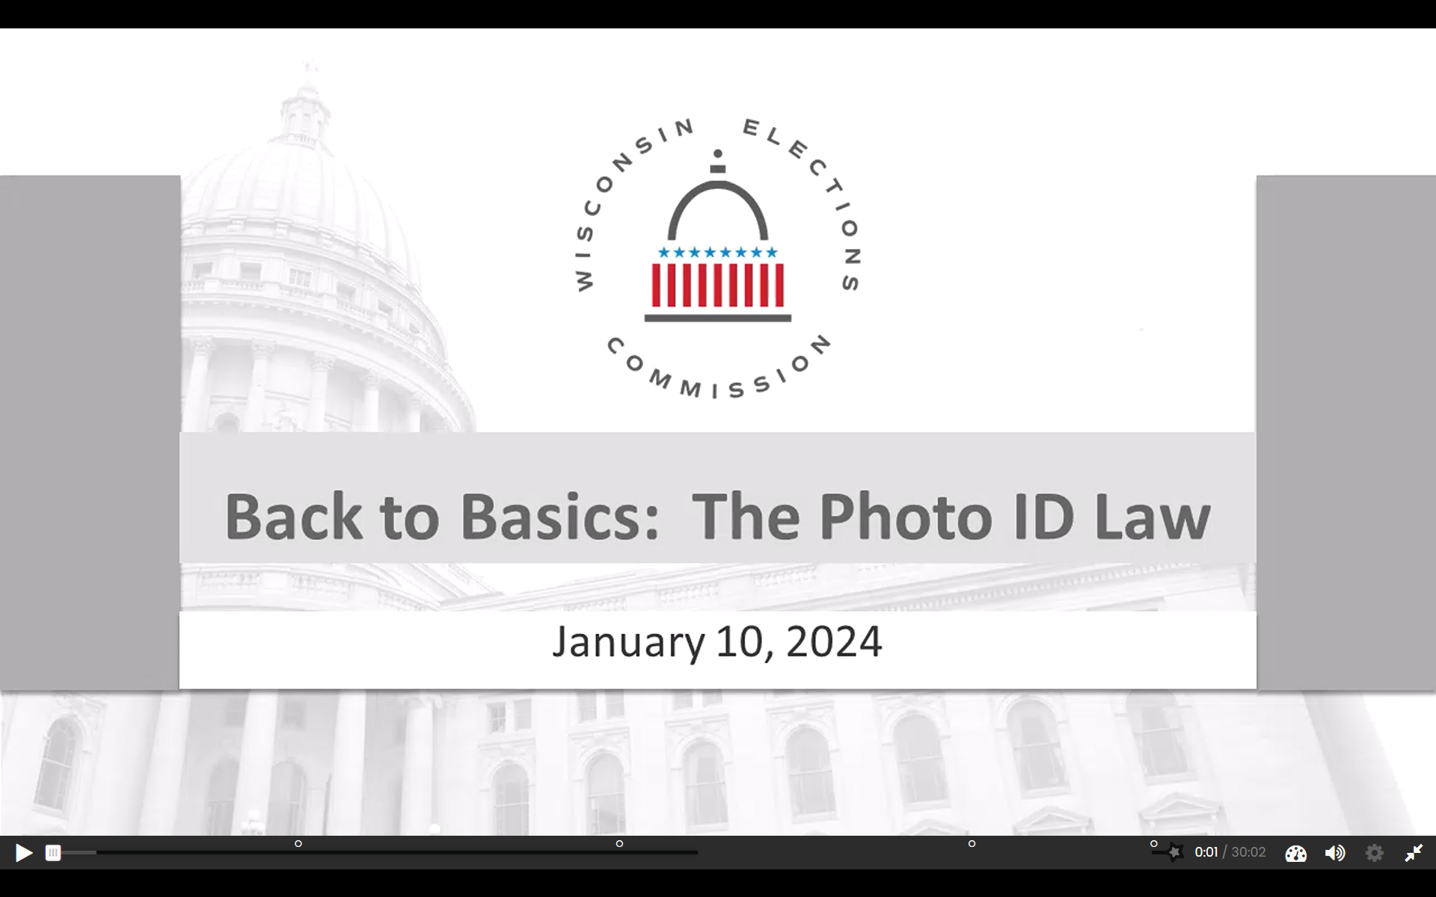

Slide 11

Update to Badger Books
End of Shift - Poll Worker Certification Screen
Protected and Confidential Voters – Judicial Privacy Act
Scan Driver’s License
Progress Bubbles

Slide 12
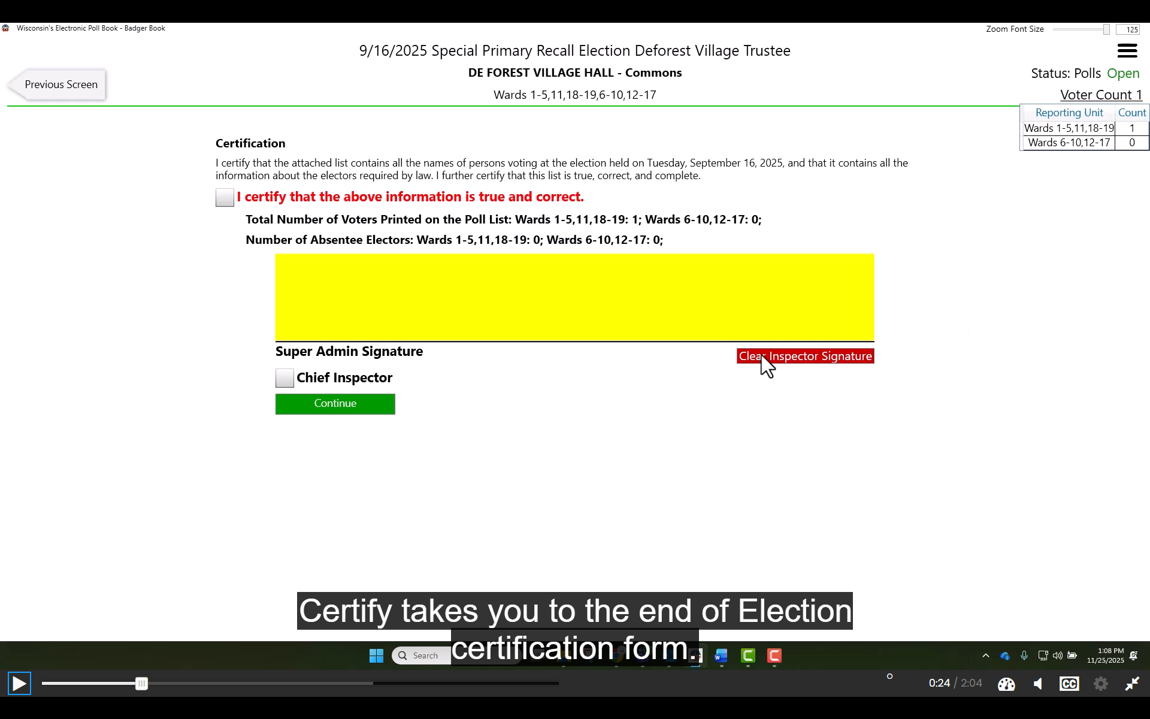

Slide 13
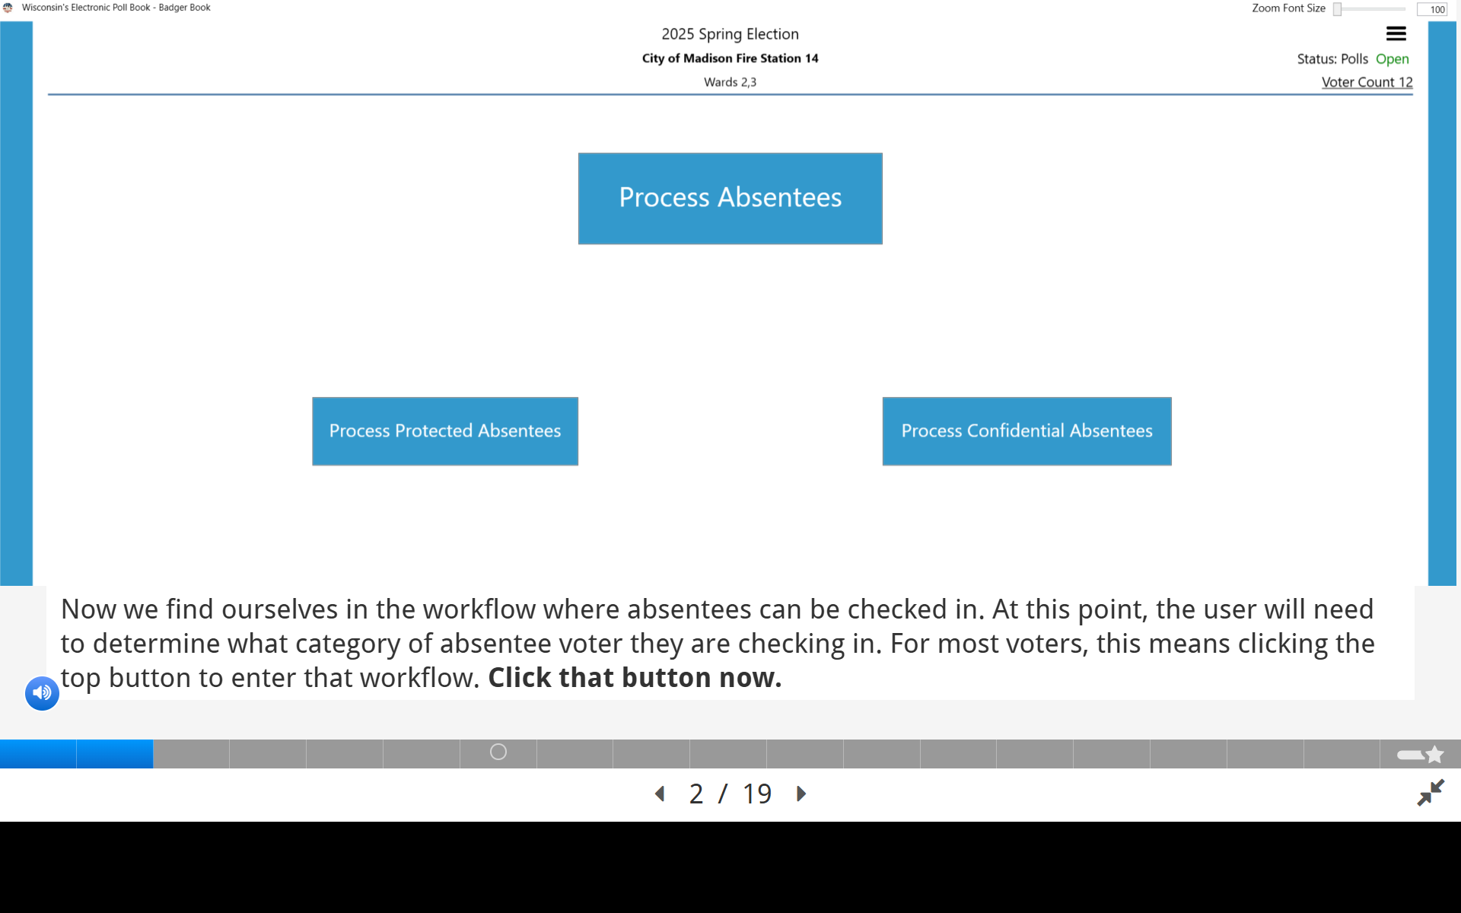

Slide 14
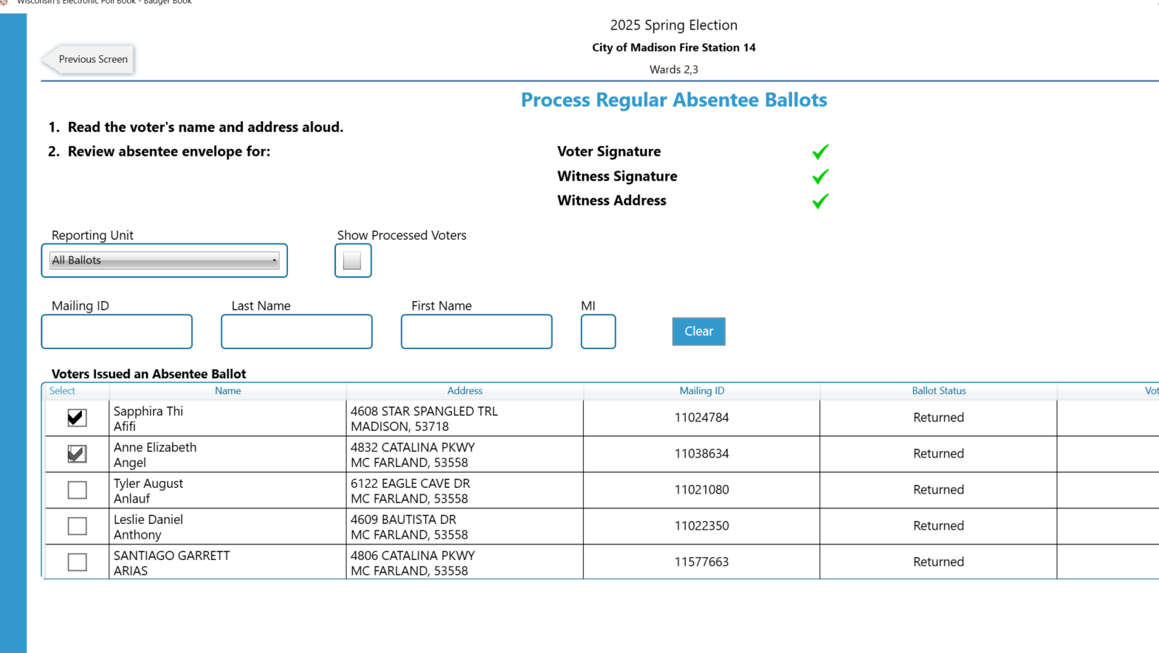
4 processes to select absentees:
scan mailing barcode
type in mailing ID number
search by name to find your voter
select voter directly from list

Slide 15
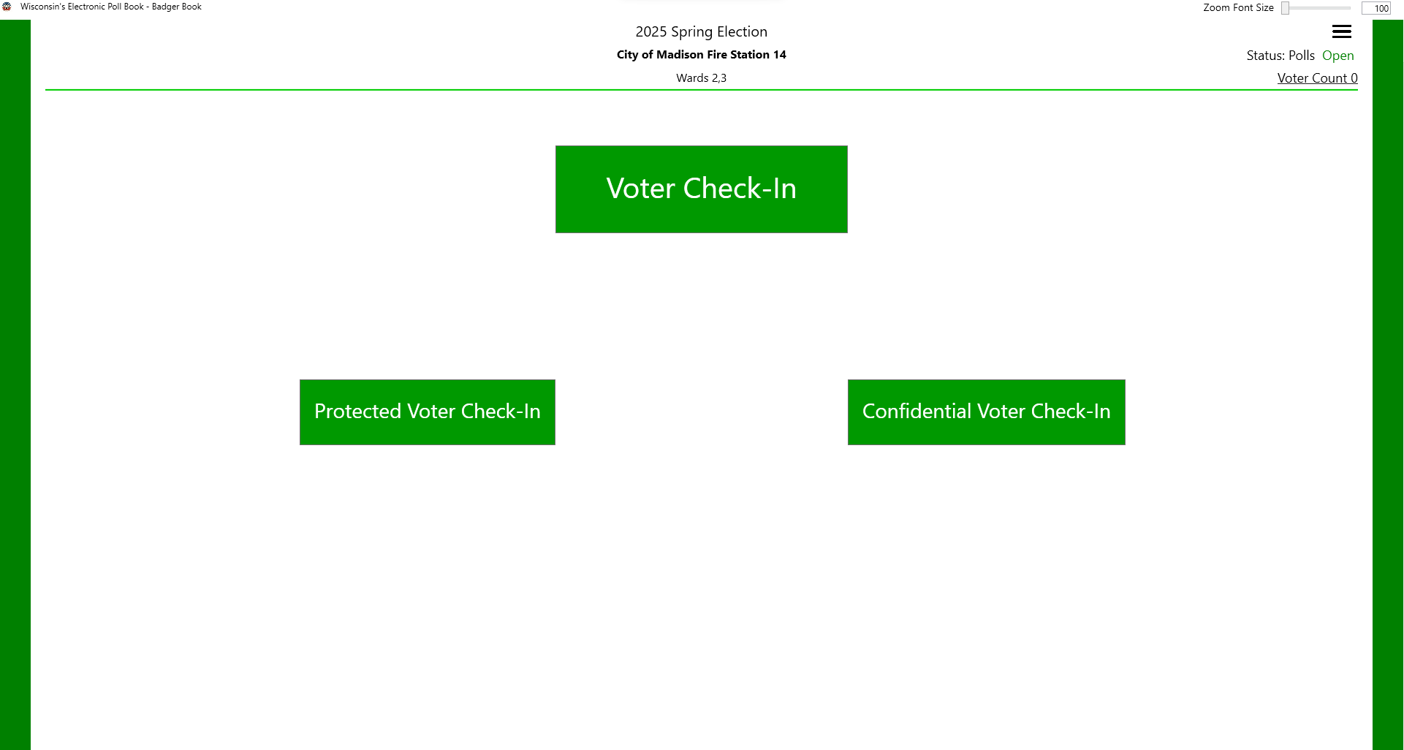

Slide 16
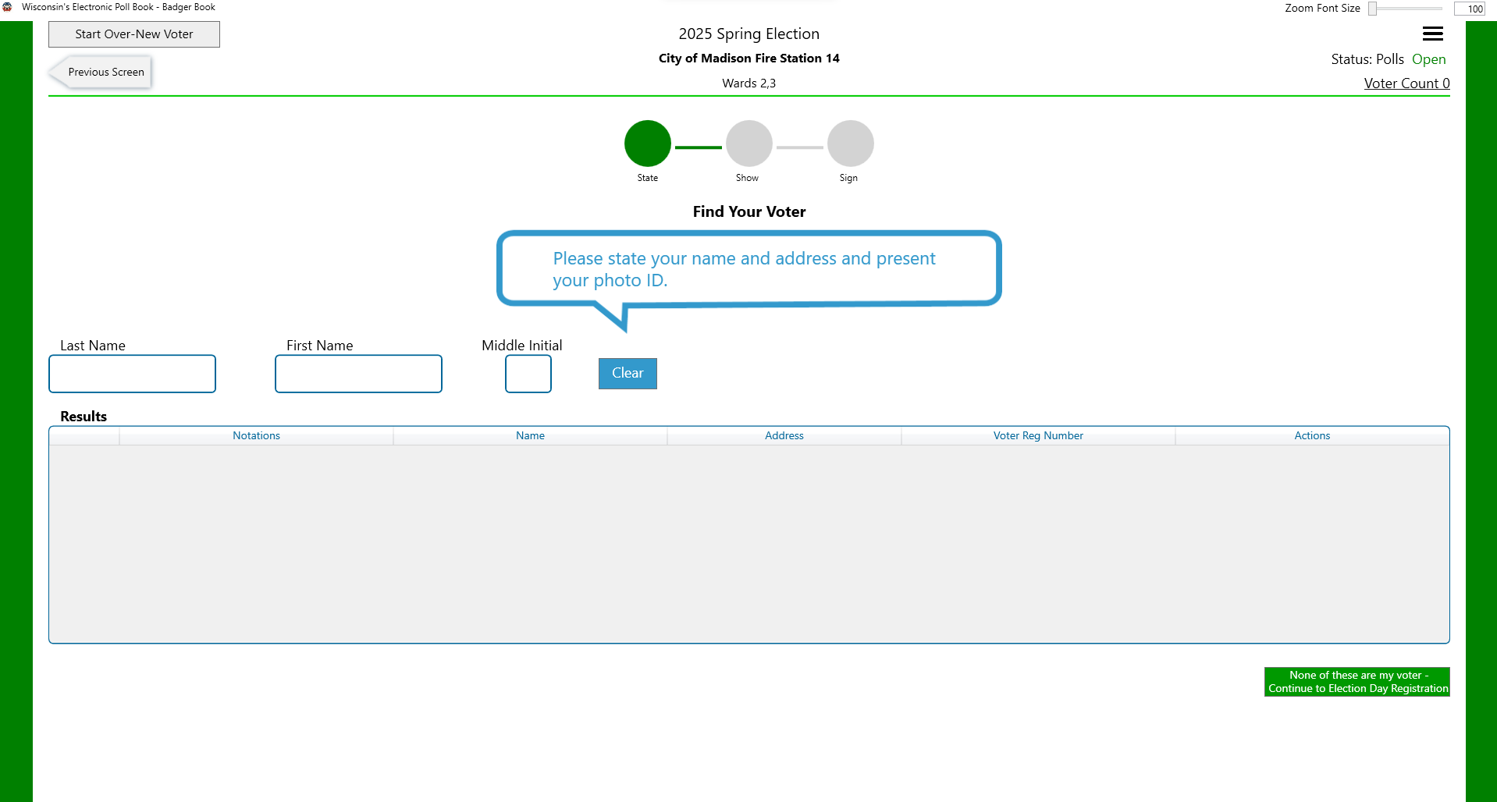
The blue speech bubbles are dialog prompts for poll workers. If you are using scanners to search for voters, you can scan a Wisconsin Driver License or Wisconsin State ID if the cursor is in the Last Name field. You can also search for the voter using the keyboard. Click the arrow > to continue.

Slide 17
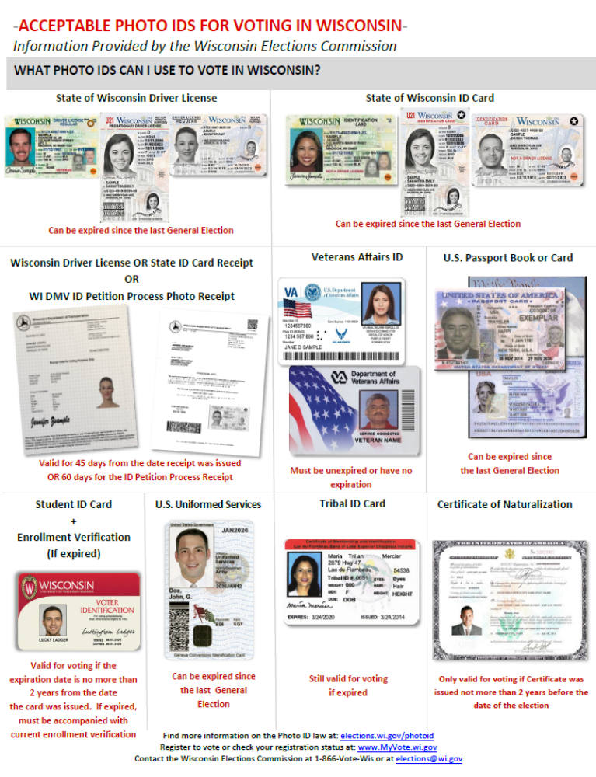
November 5, 2024.

Slide 18
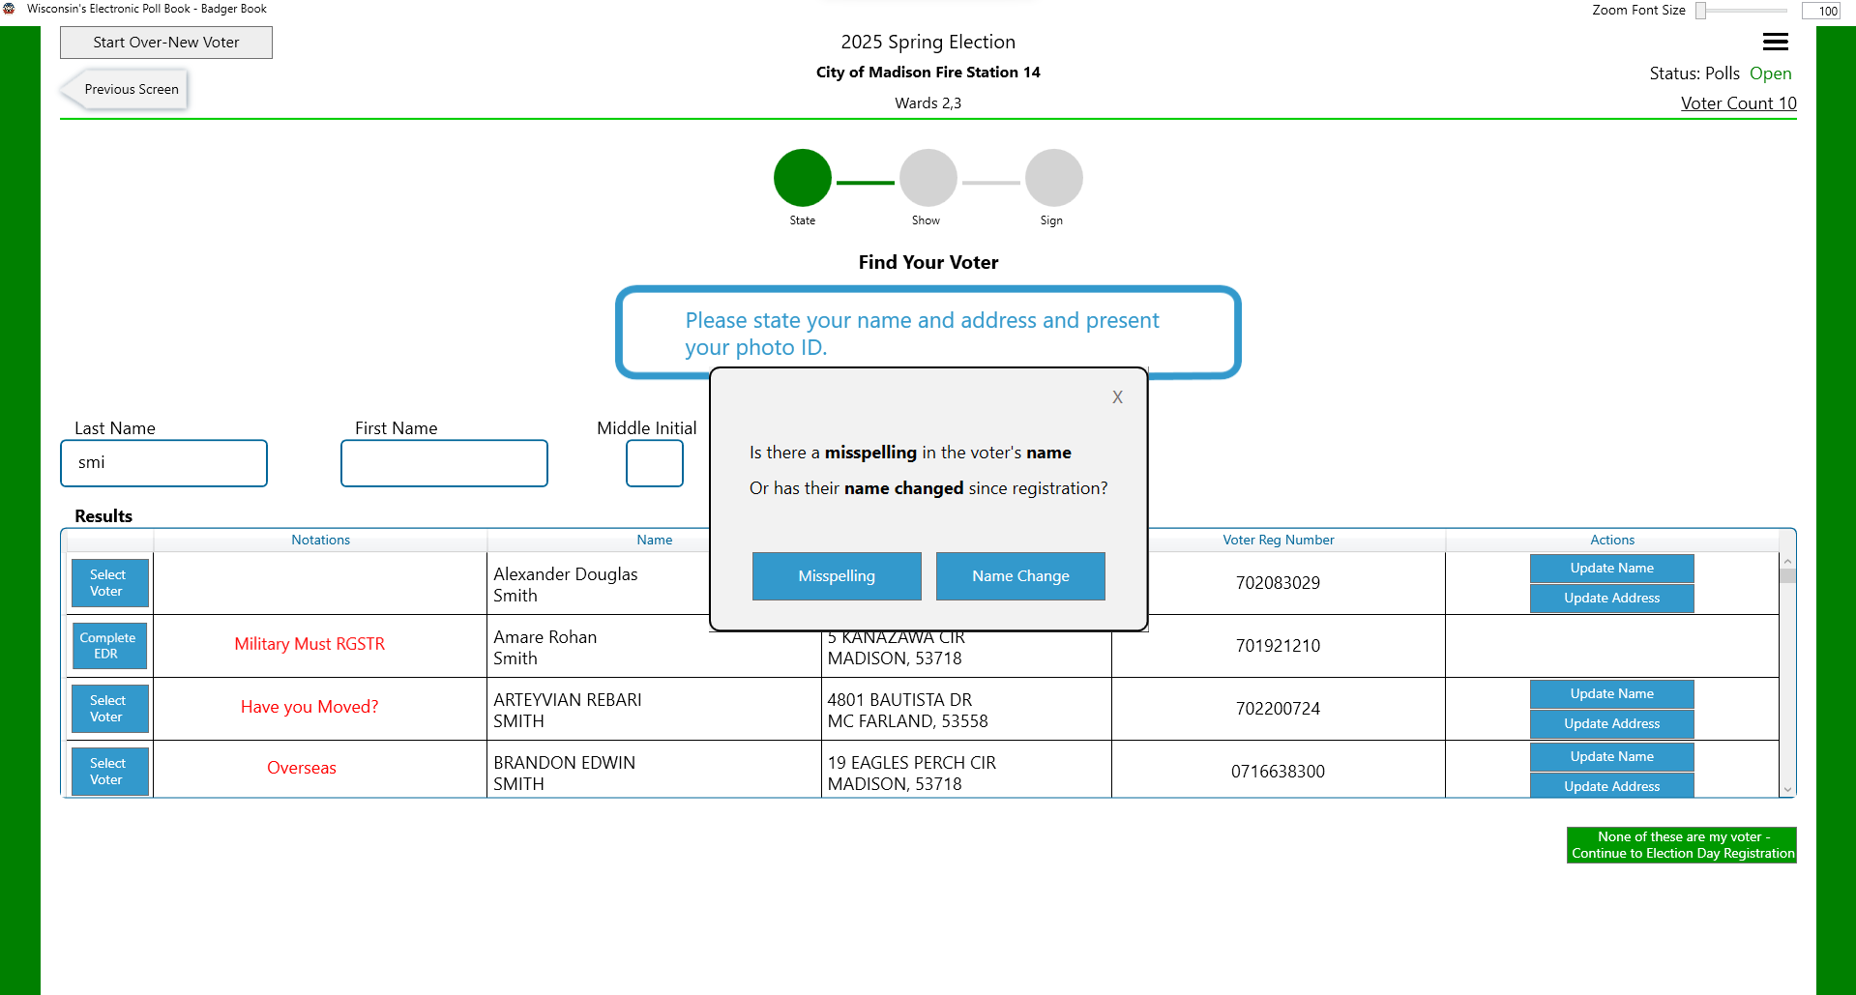

Slide 19
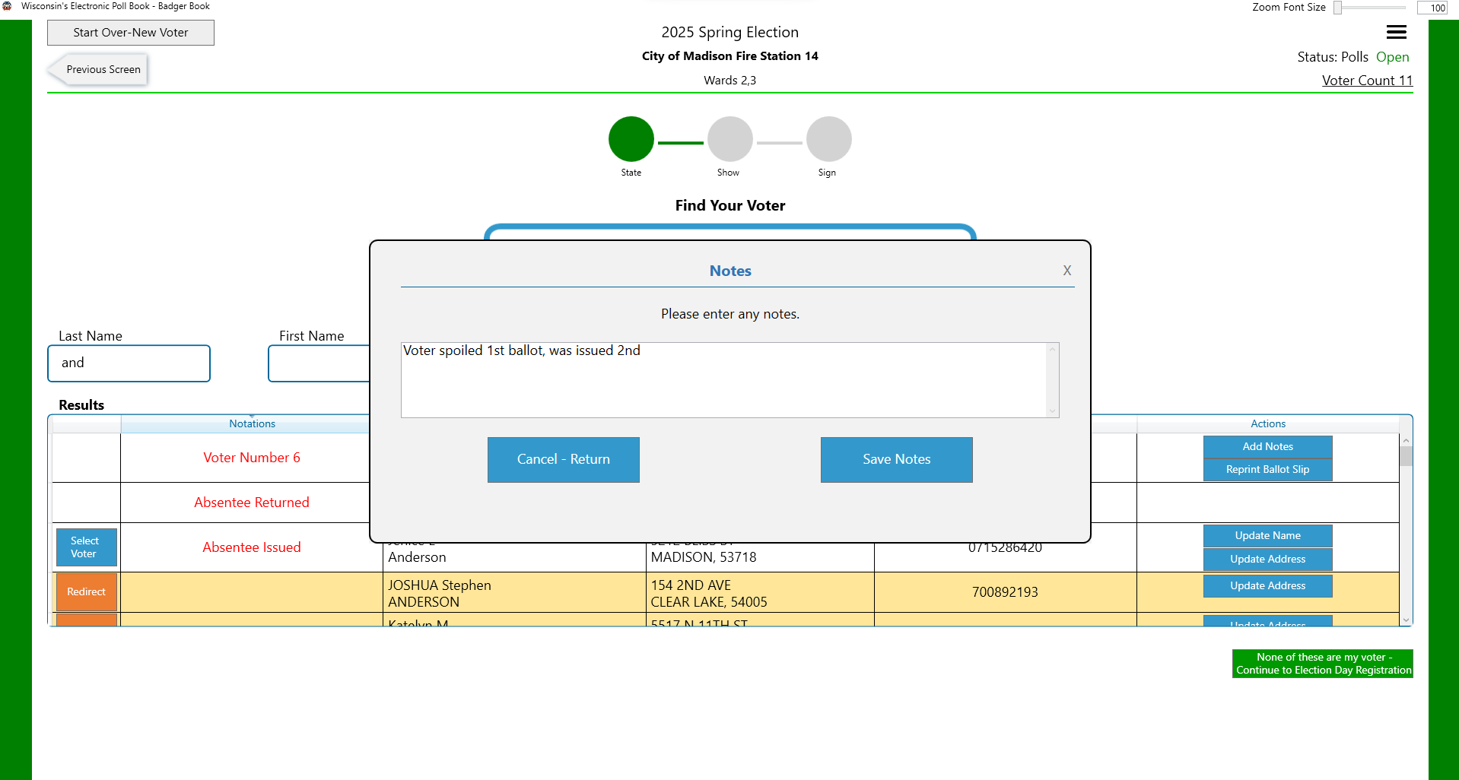

Slide 20
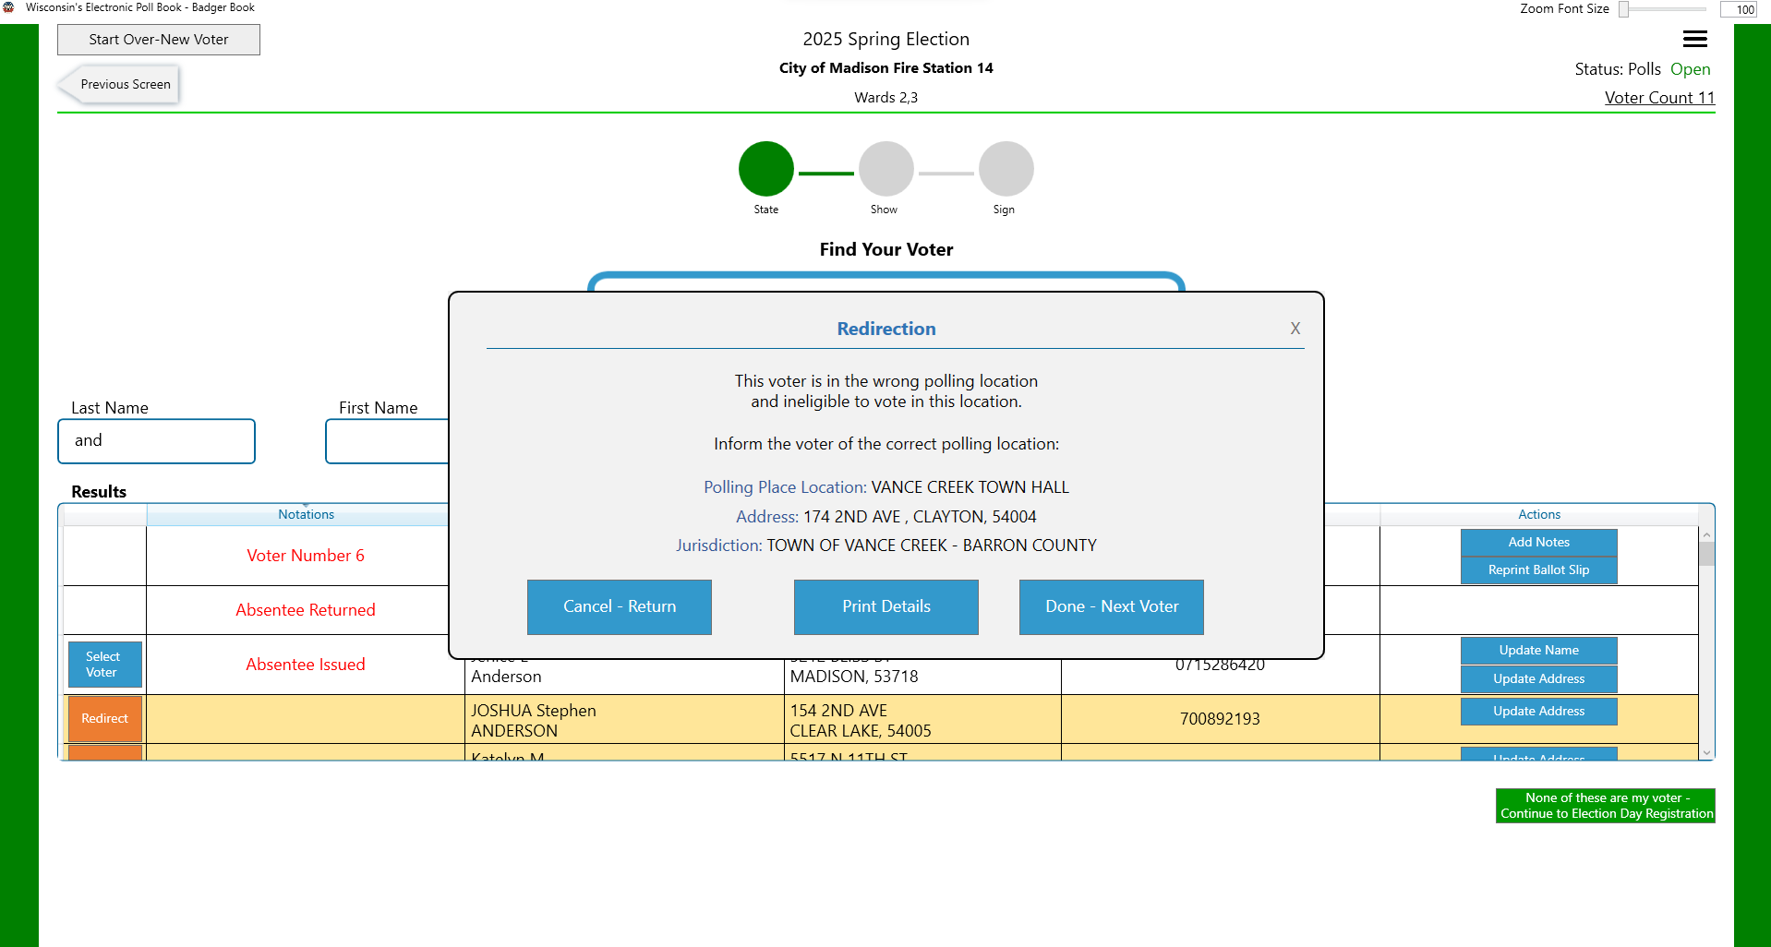

Slide 21
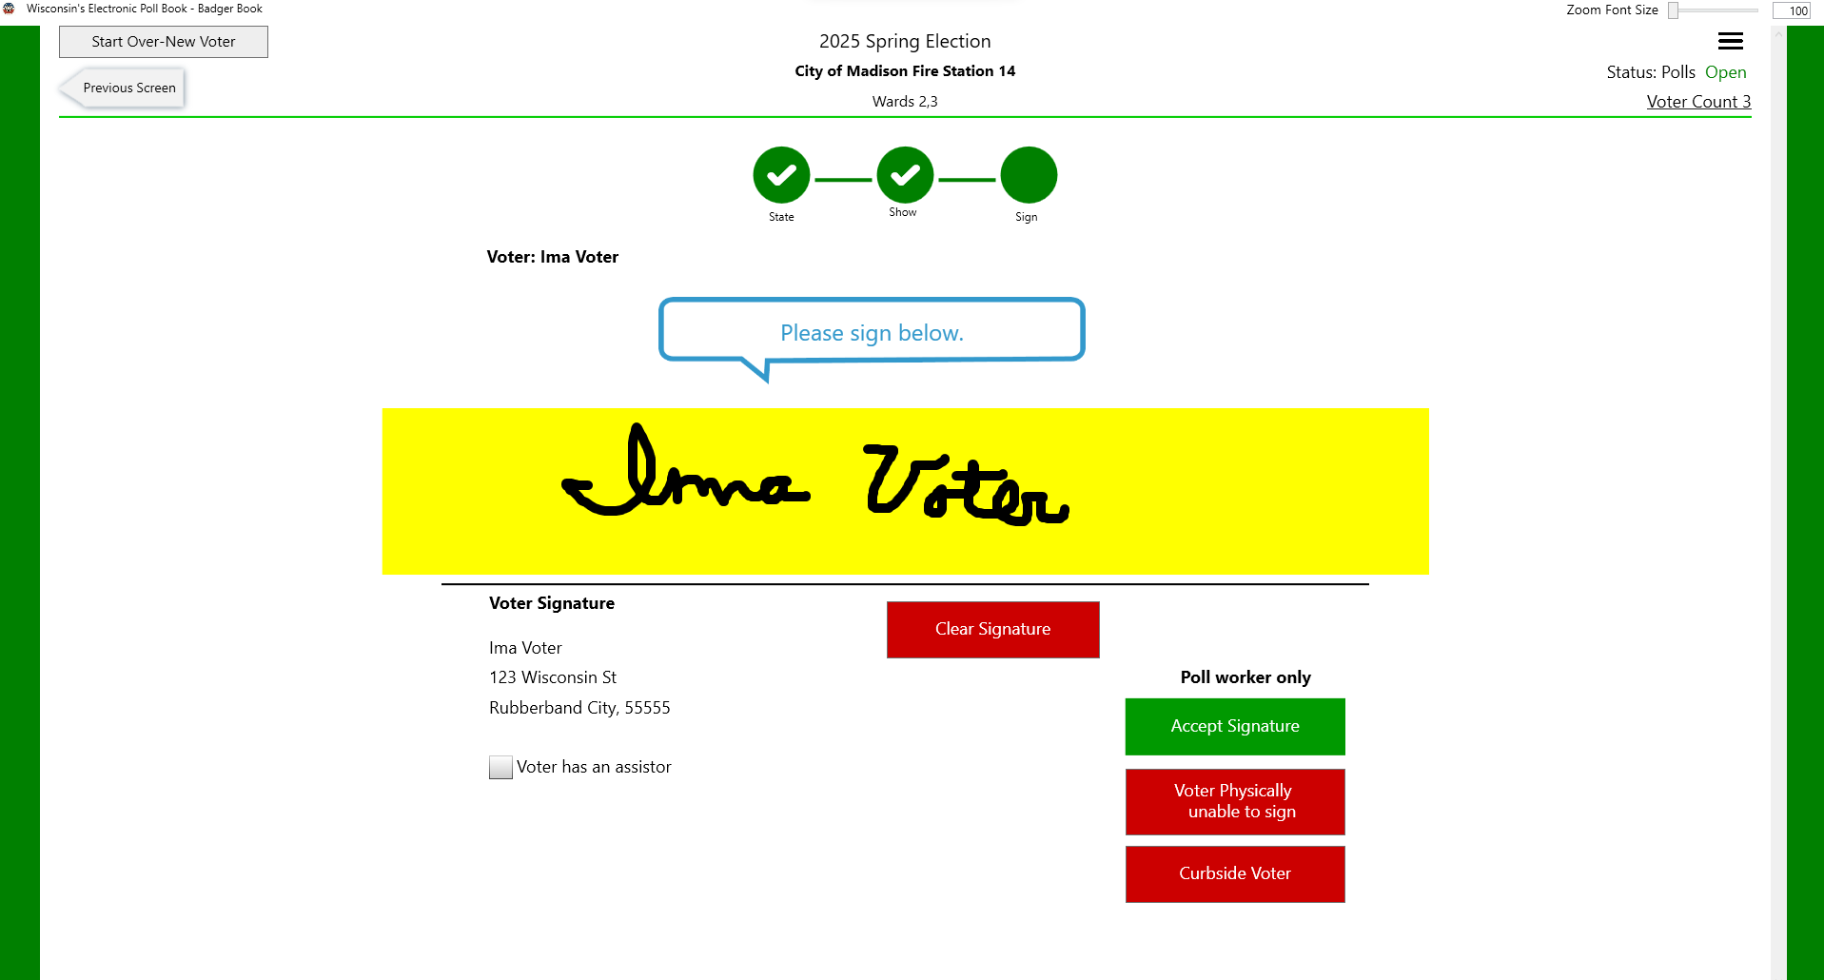

Slide 22
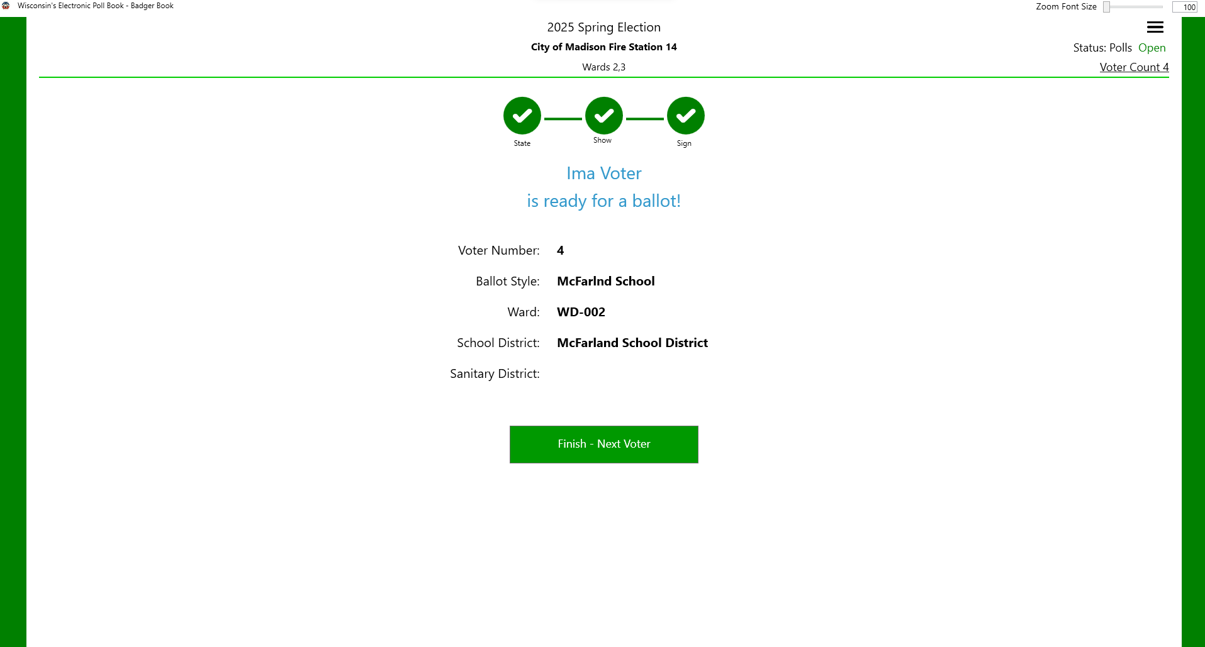

Slide 23
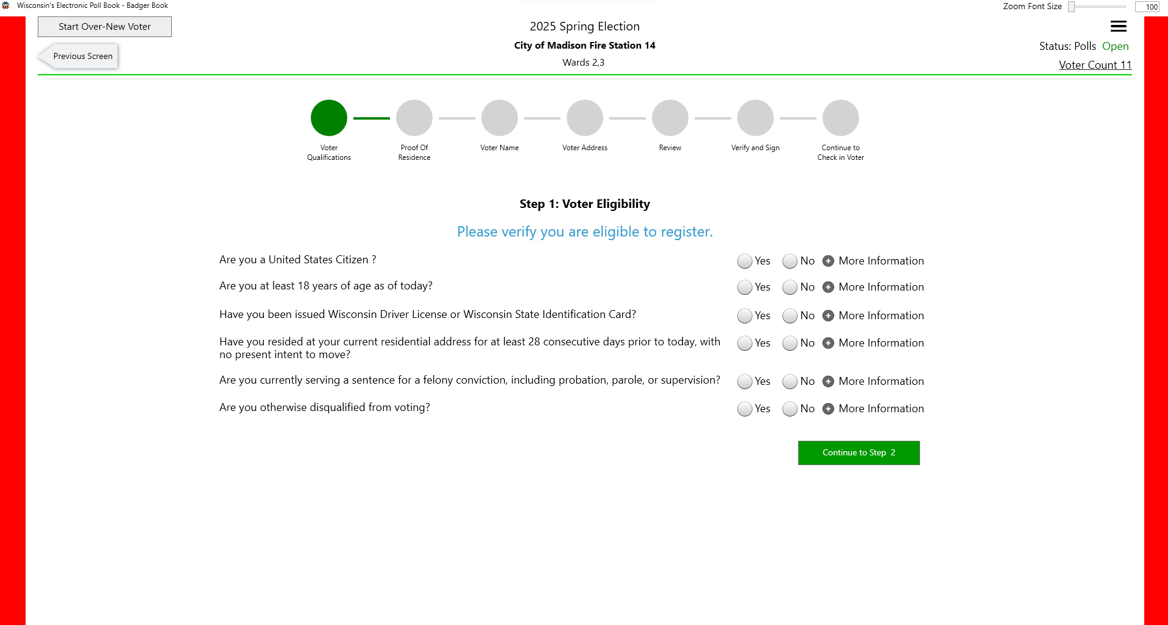

Slide 24
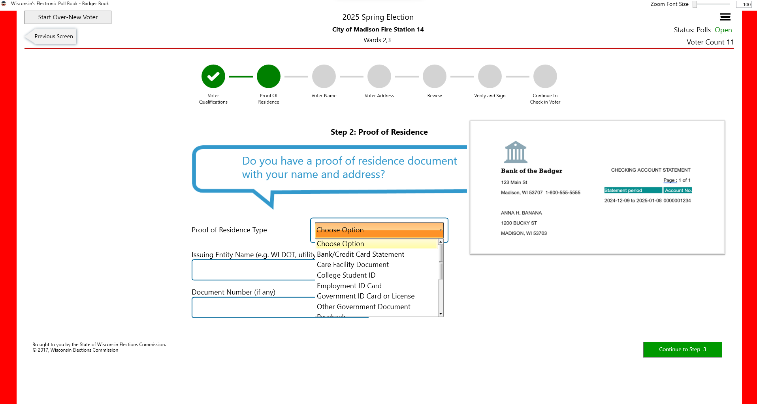

Slide 25
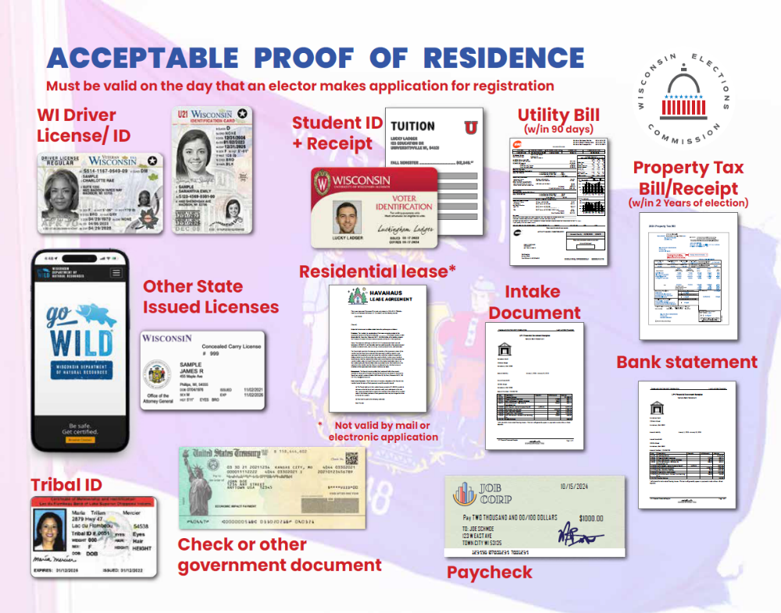

Slide 26
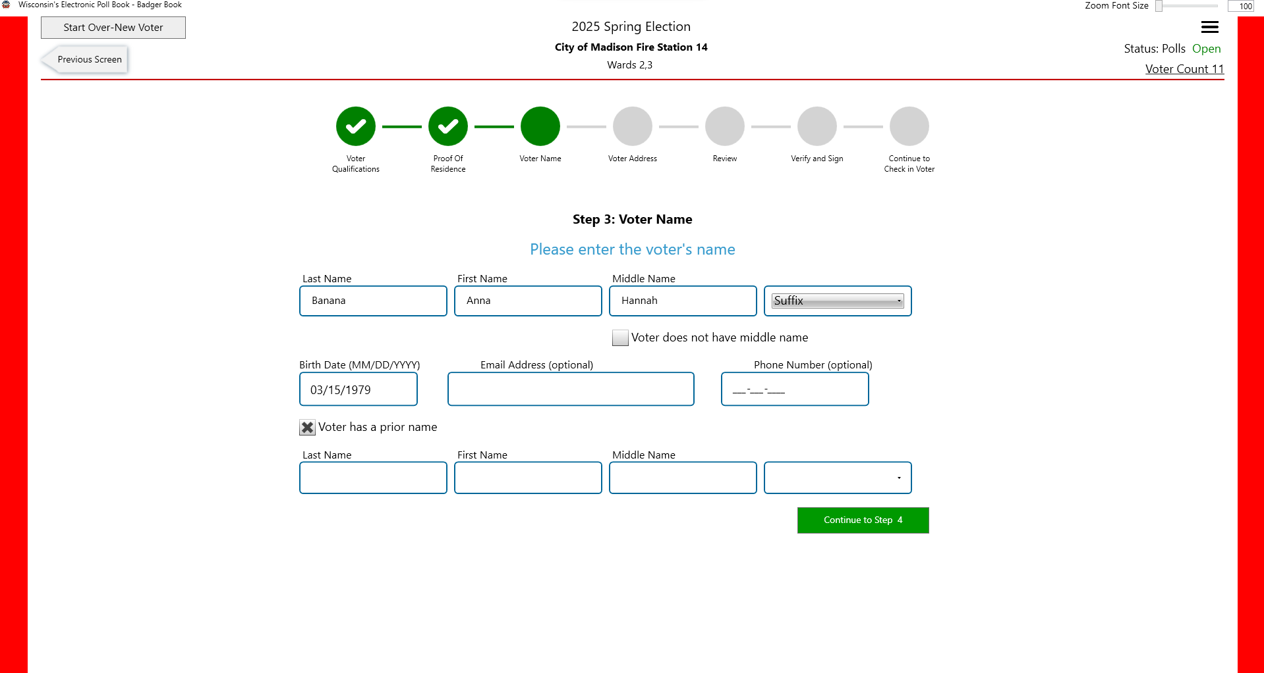

Slide 27
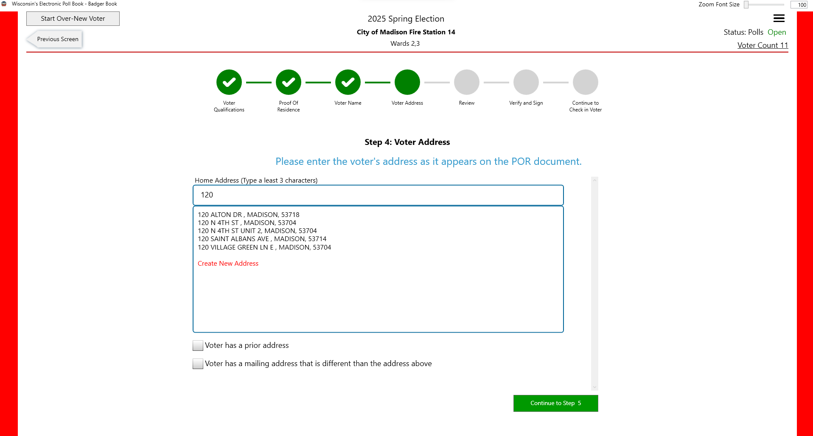
A dropdown of all the addresses in that jurisdiction with the matching information will appear. If none are the address you are looking for, you will need to click on Create New Address. Ms. Banana’s new address, 1200 Bucky Street, has not yet been entered into WisVote. Click “Create New Address” at the bottom of the search results.

Slide 28
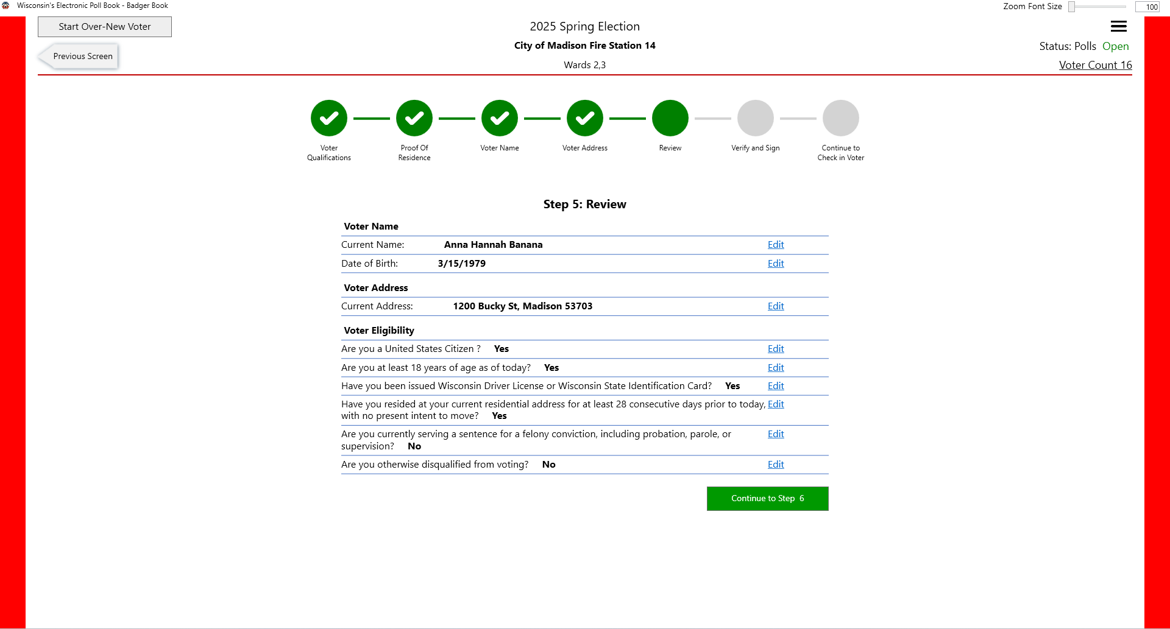
Turn the screen to the voter to verify name, date of birth, and address are correct. If any field is wrong, click Edit to go to that section to fix it. If everything is fine, the voter clicks Continue to Step 6. Do that now.

Slide 29
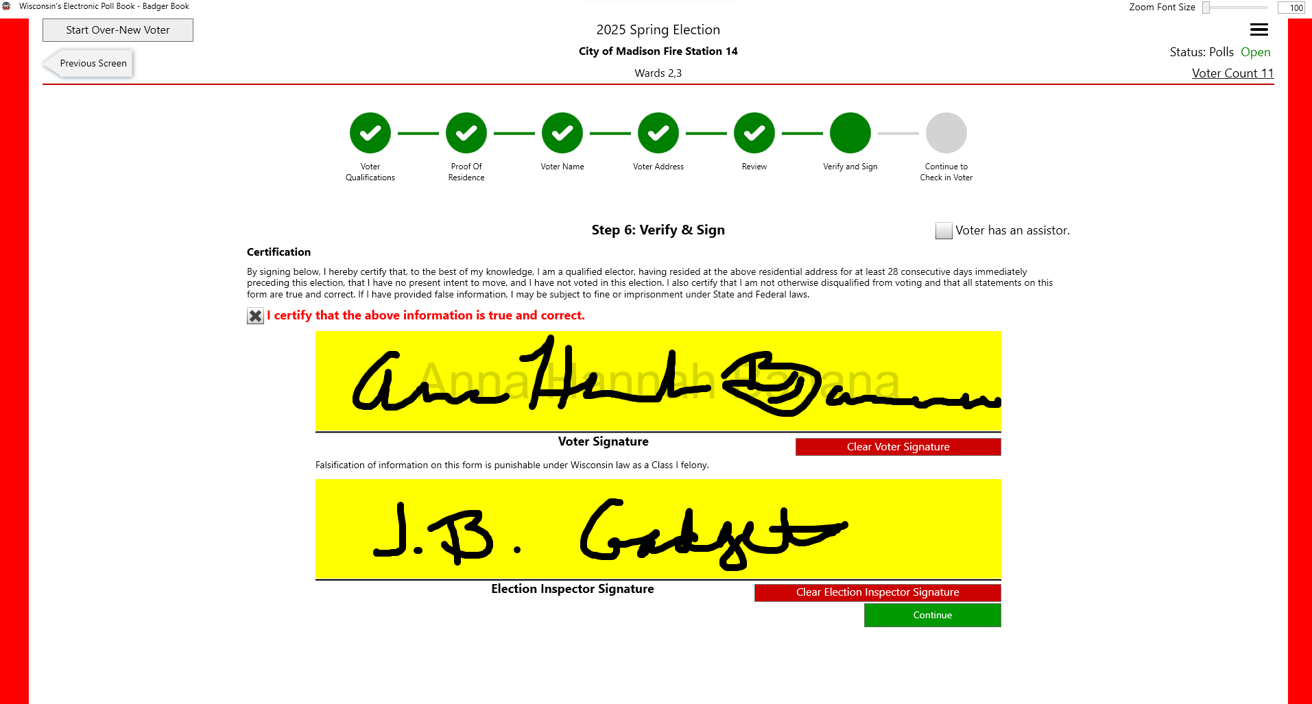

Slide 30
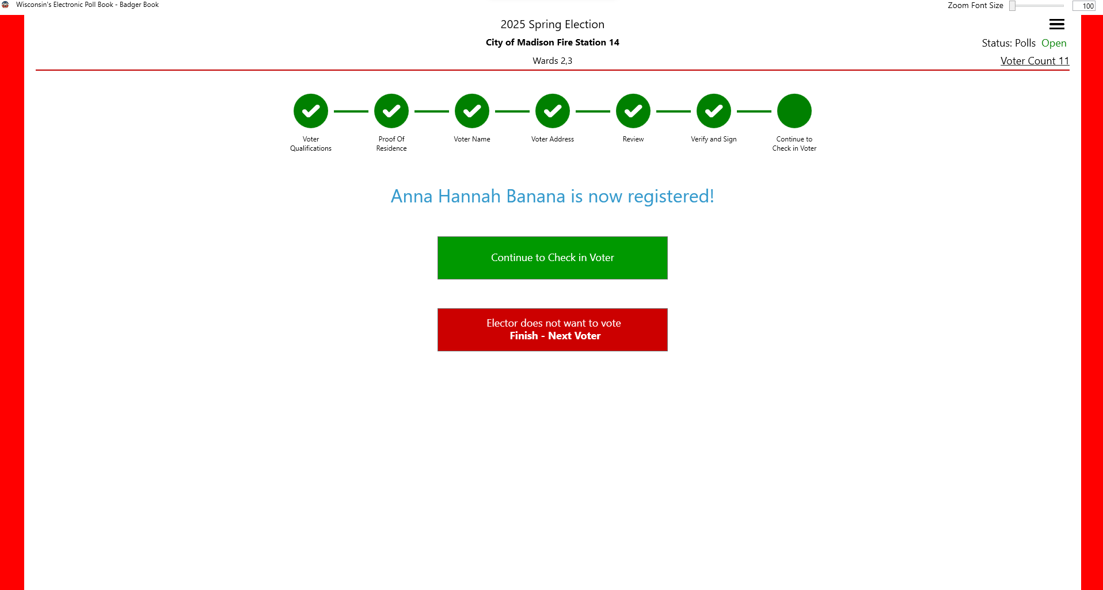

Slide 31
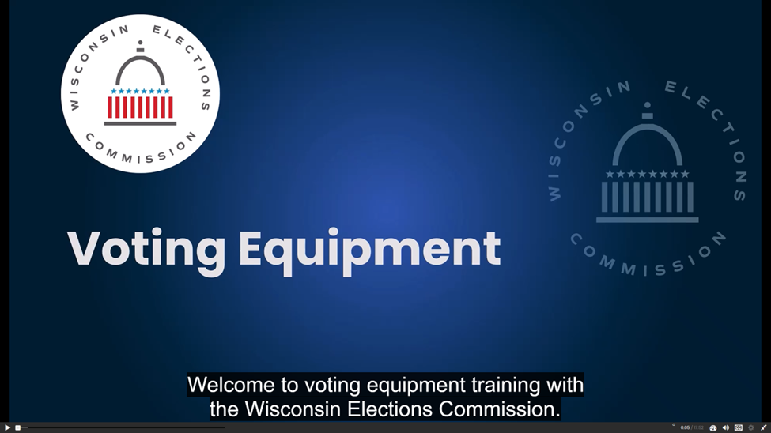

Slide 32
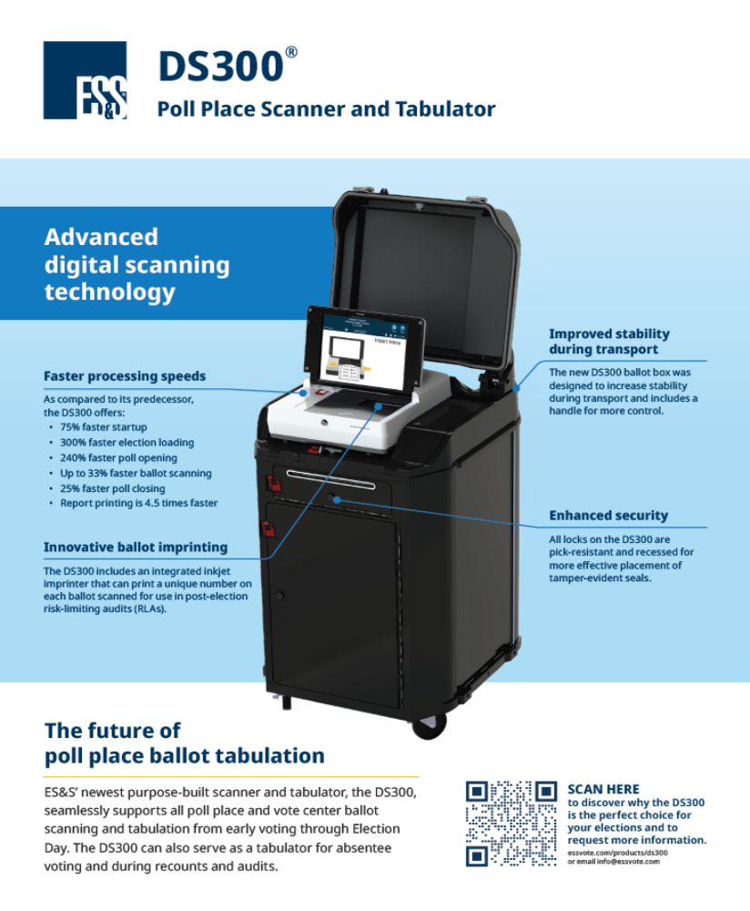
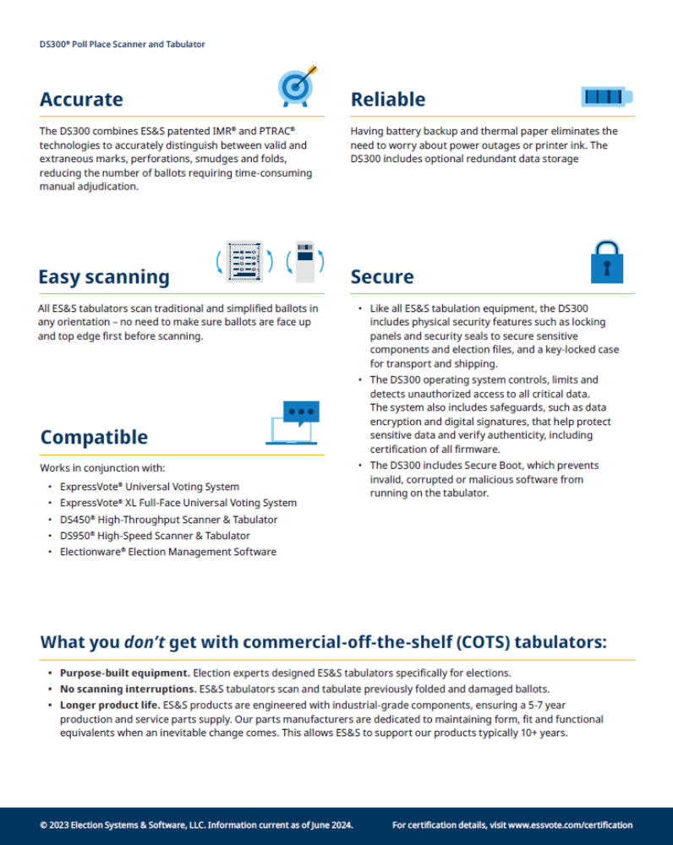

Slide 33
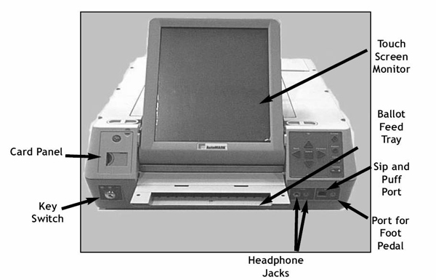
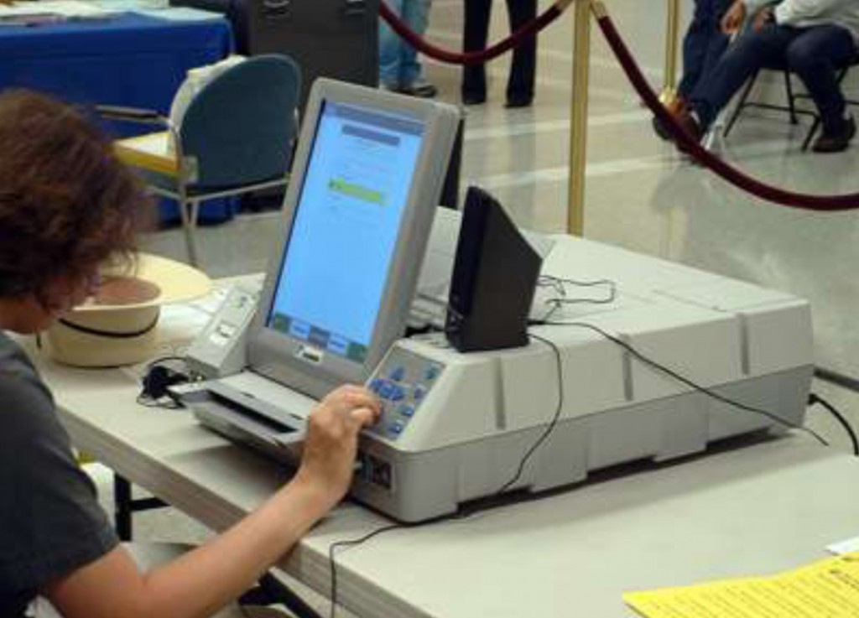
Election Systems & Software
AutoMARK
Equipment Type: Ballot Marking Device

Slide 34
Communication and Availability
Must respond via email for every election on availability
Stephanie will use email responses on availability to create schedule
If you have questions, please email
We appreciate everyone willing to be a poll worker! Thank you!

Slide 35
Questions?

Slide 36
Thank you

