Slide 1


How Your Customers
Will Pay Online & by Phone

Slide 2
Customer payment options
Whether your customers pay by phone or online, it’s simple.
On their first online visit or call, they will validate themselves against your customer database which is loaded in PSN
They can then add information to their profile and make their first payment
For any visit or call after that, they simply make a payment
Importantly, we have live operator assistance should they need help. You can simply refer calls you may get to us.
Here’s how it works…

Slide 3


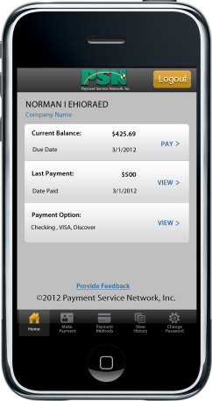
Who pays by phone v. online
Each PSN account can be set up differently as to what payments can be made by phone and online. Your customers…
REMEMBER: Mobile payments = online payments

Slide 4
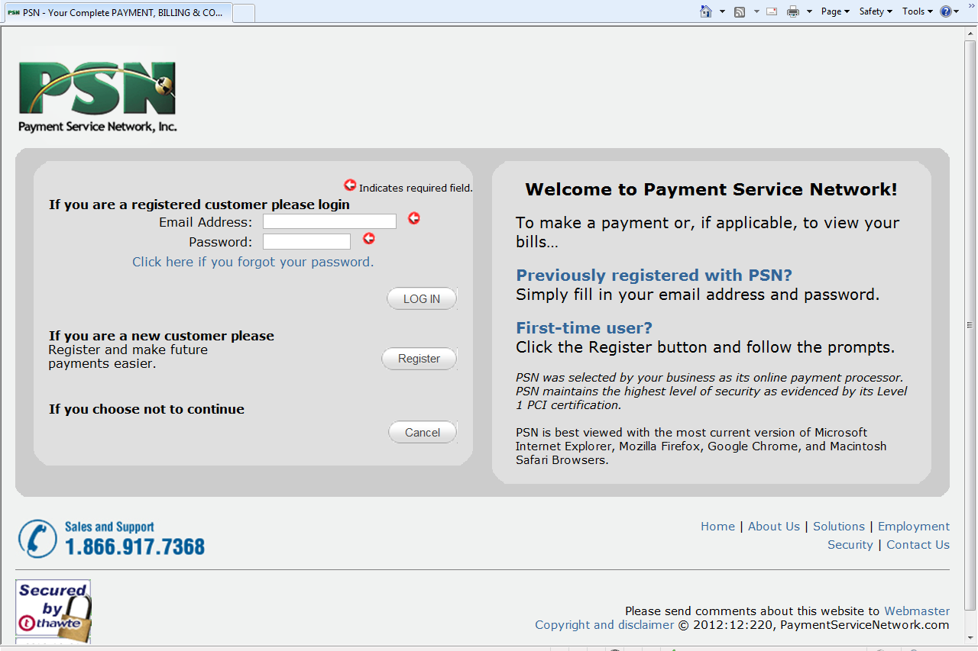
Online payments
Validation process…
  Customer will go to your website and click on a payment link which takes them to this PSN page
  Customer should select Register the first time they go online to make a payment or view a bill

Slide 5
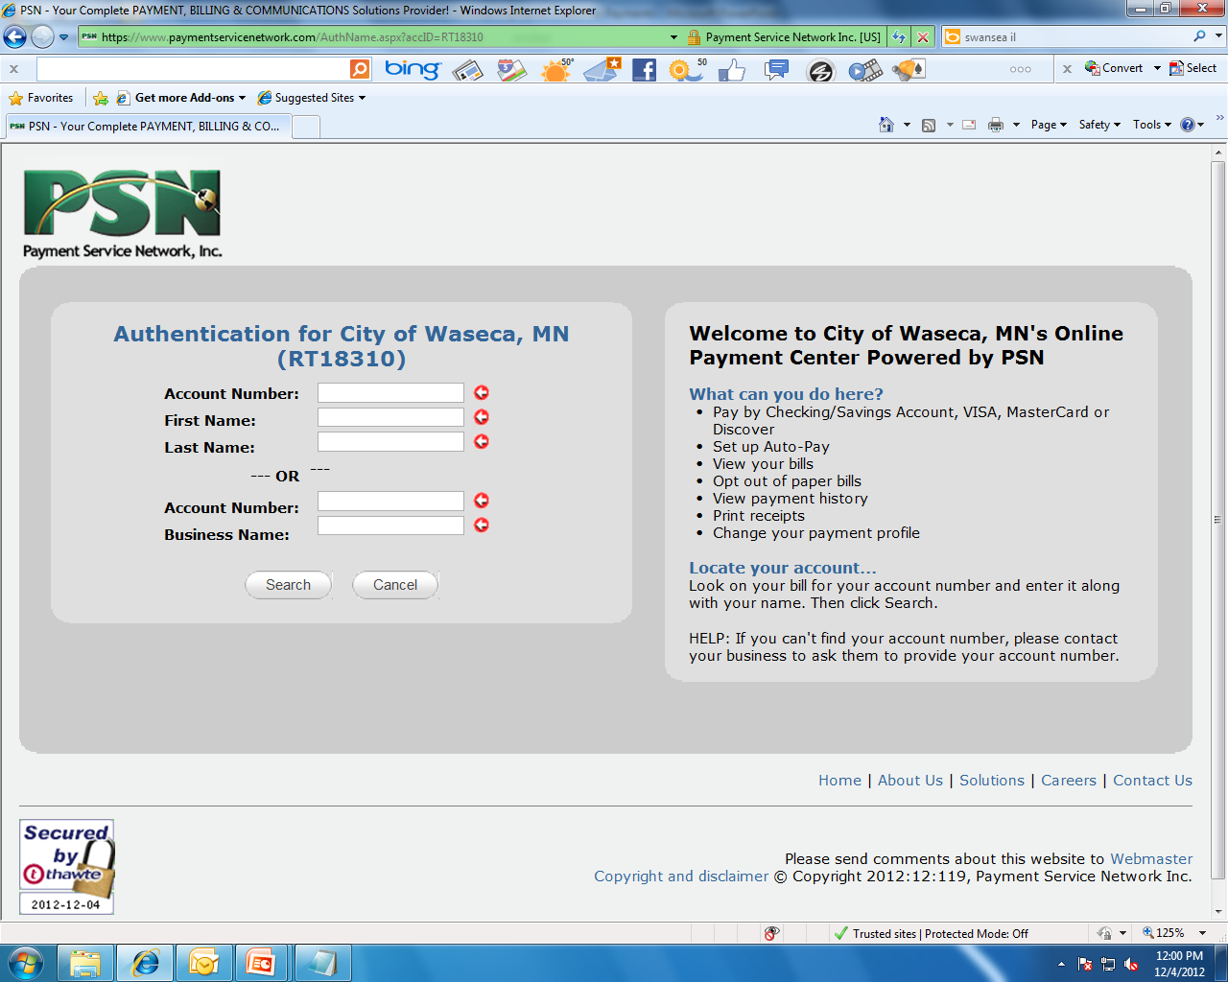

Online payments
Validation process…
  Customer will enter their:
    Utility Customer Account Number
    First Name (optional)
    Last Name
    HELP: Their name should be entered as it is listed on
    their bill
    Select “Search”
Your Name Appears Here
Your Name Appears Here
xxxxx

Slide 6
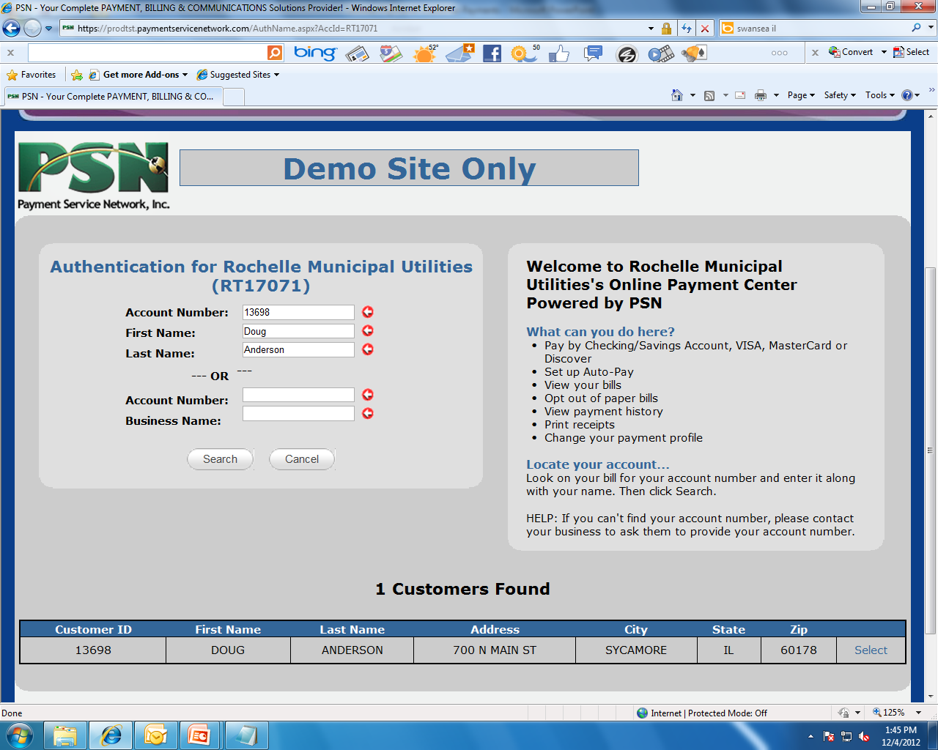
Online payments
Validation process…
Your Name Appears Here
Your Name Appears Here
  Customer info will appear at the bottom of the screen; if correct, they should click “Select”
  PSN then authenticates and your customer is validated
xxxxx
1234567 Jane Doe 123 Main Street Anywhere WI 12345

Slide 7
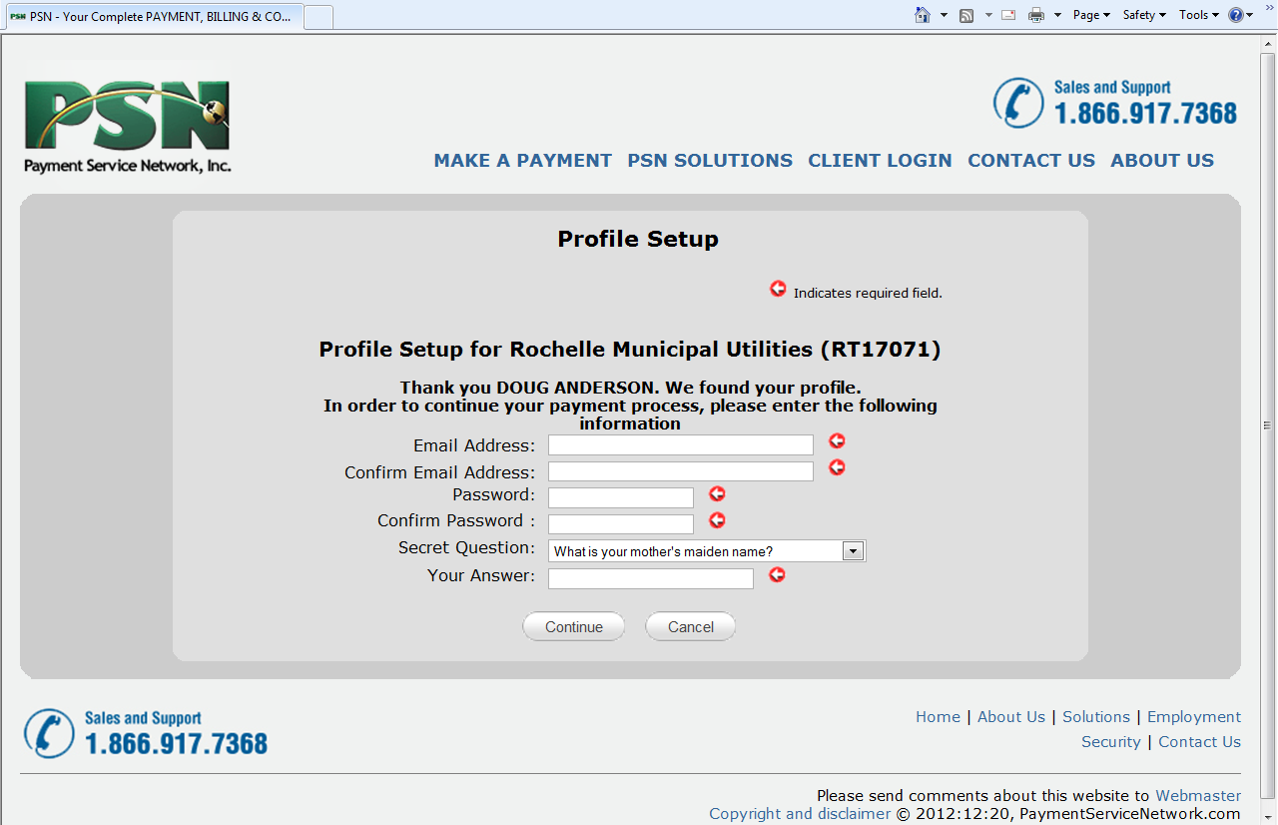
Online payments
Customer Profile Setup
  Customer will now create their profile by providing:
    Email address
    Password
    Secret question
  This information is their login info to make future pay-ments just a 3-step process.
Your Name Appears Here
xxxxx
Customer Name

Slide 8
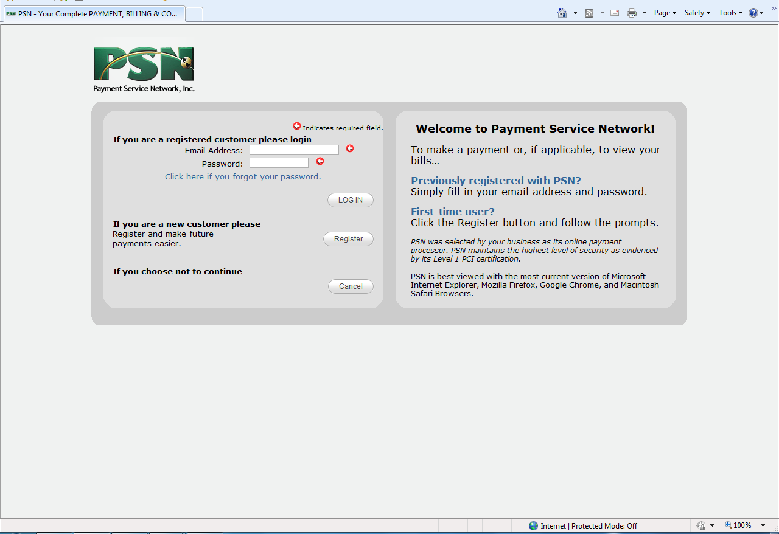
Online payments
Returning Customers
  The next time your customer logs into make a payment or view their bill, they simply enter the login information they previously set up (email address and password).

Slide 9
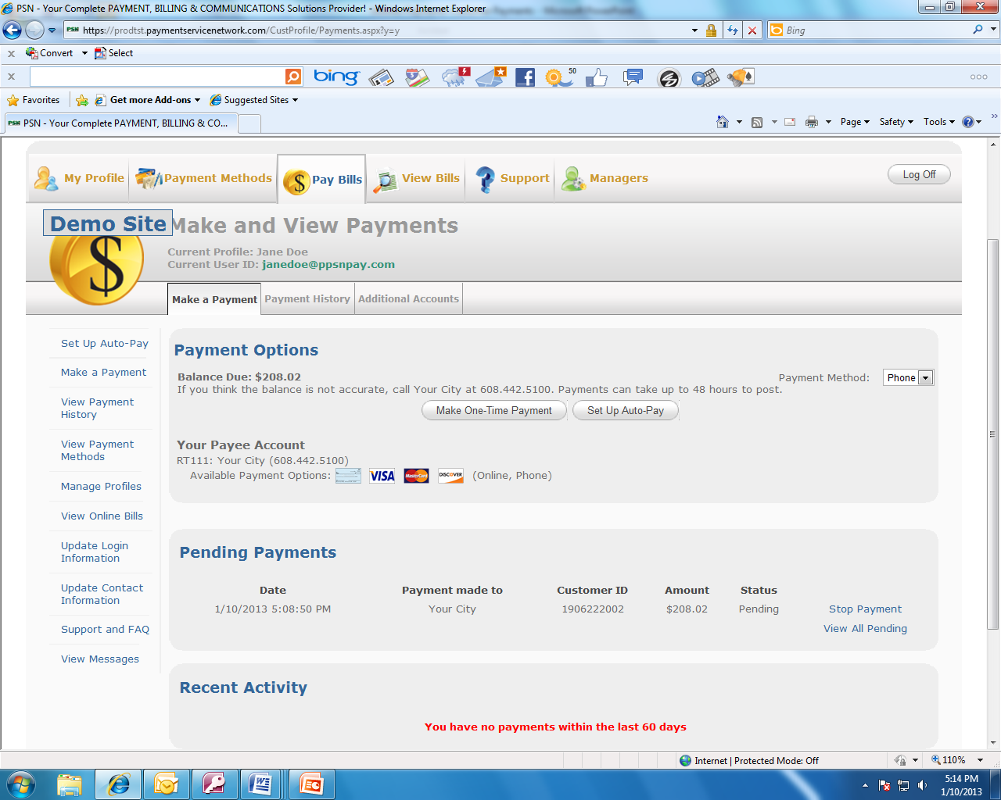
Online payments
Making a One-time Payment
  STEP 1.
  Customer selects to make a one-time payment
Smart display
Pending, problem and recent payments appear here

Slide 10
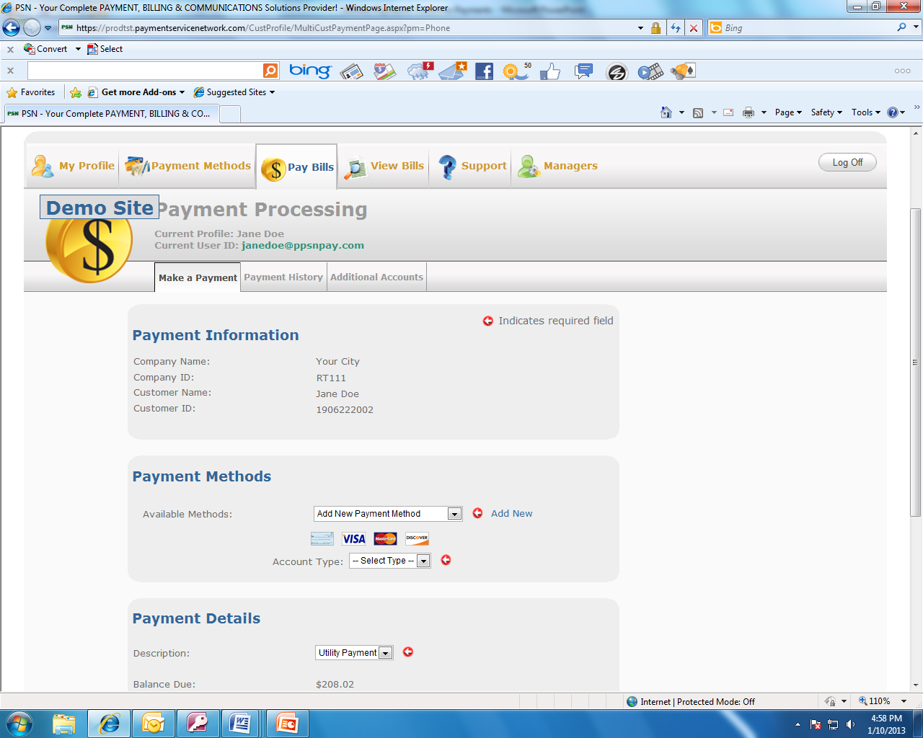
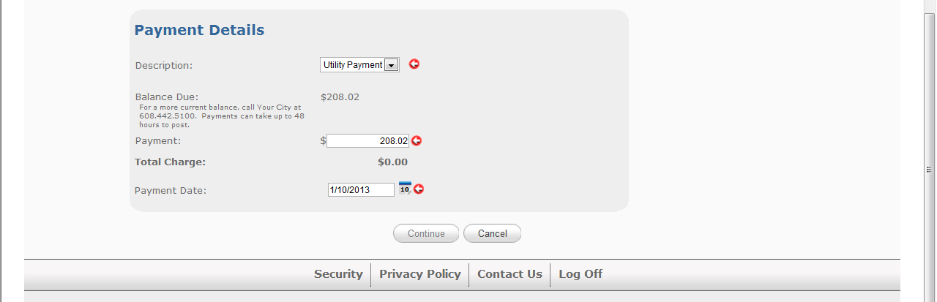
Online payments
Making a One-time Payment
  STEP 2.
  Customer makes payment
Smart display: Customer doesn’t need to do anything in this section
Smart display of payment methods that you have authorized (check, VISA, etc.). Customer selects type of account and completes the information requested.
Smart display
Customer inputs the amount of payment and the payment date; then selects “Continue.”

Slide 11
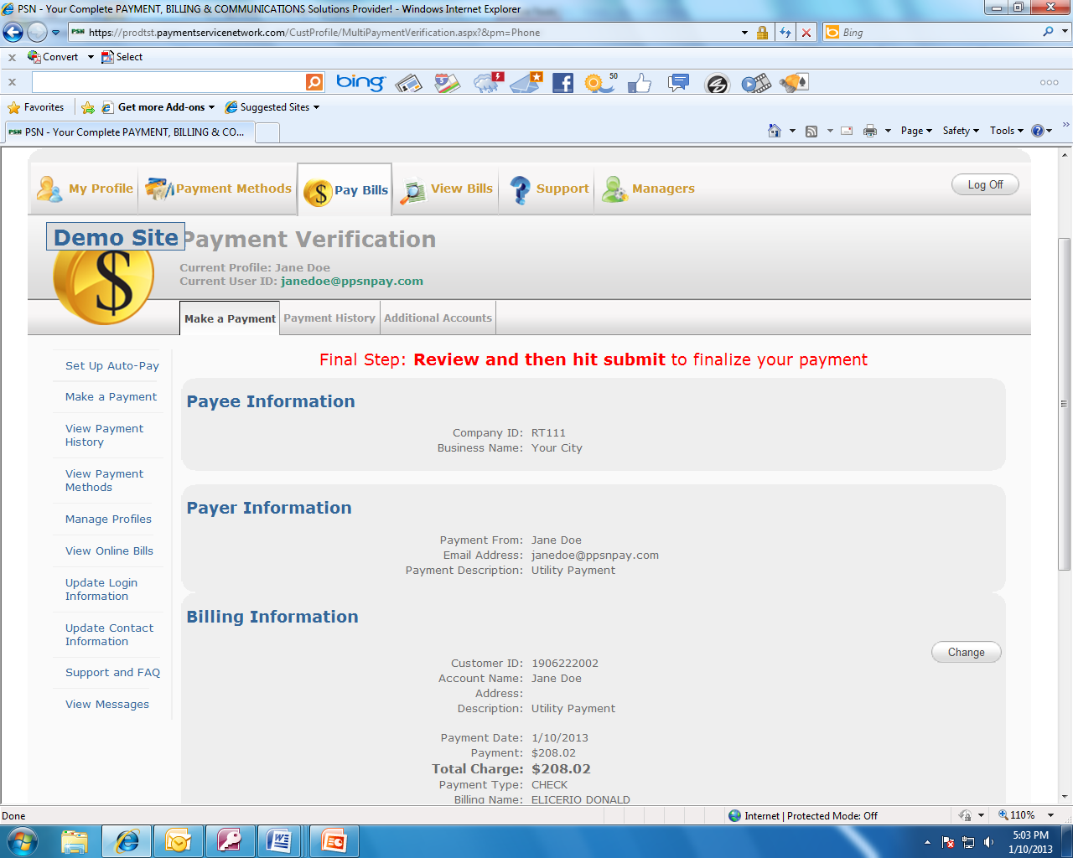
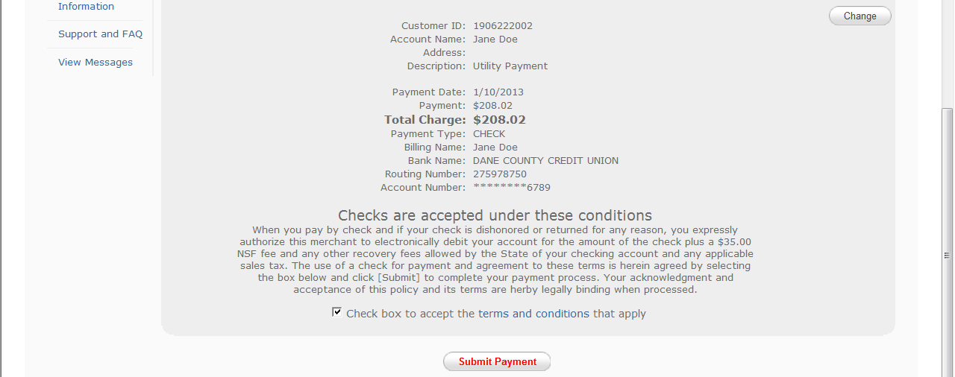
Online payments
Making a One-time Payment
  STEP 3.
  Customer confirms and submits payment

Slide 12
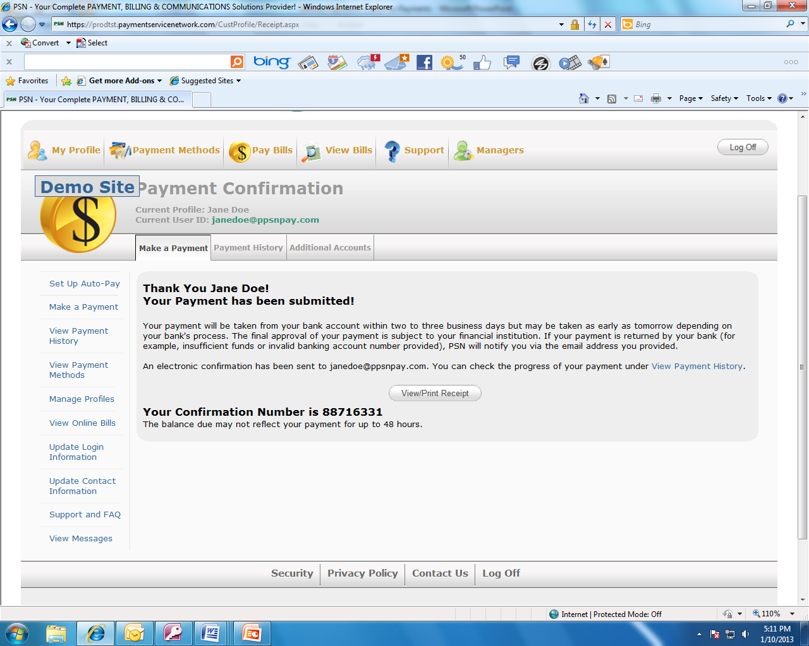
Online payments
Making a One-time Payment
  Customer can view
  or print a receipt

Slide 13
Online payments
Setting up Auto-Pay
  STEP 1.
  Customer selects
  Set up Auto-Pay
Smart display

Slide 14
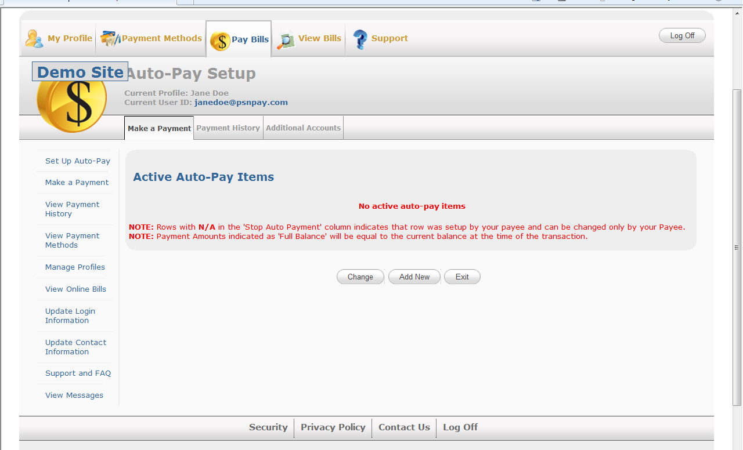
Online payments
Setting up Auto-Pay
  STEP 2.
  Customer selects Add New. (Customer can also change an existing Auto-Pay, such as changing a payment method or the date of the payment.)

Slide 15
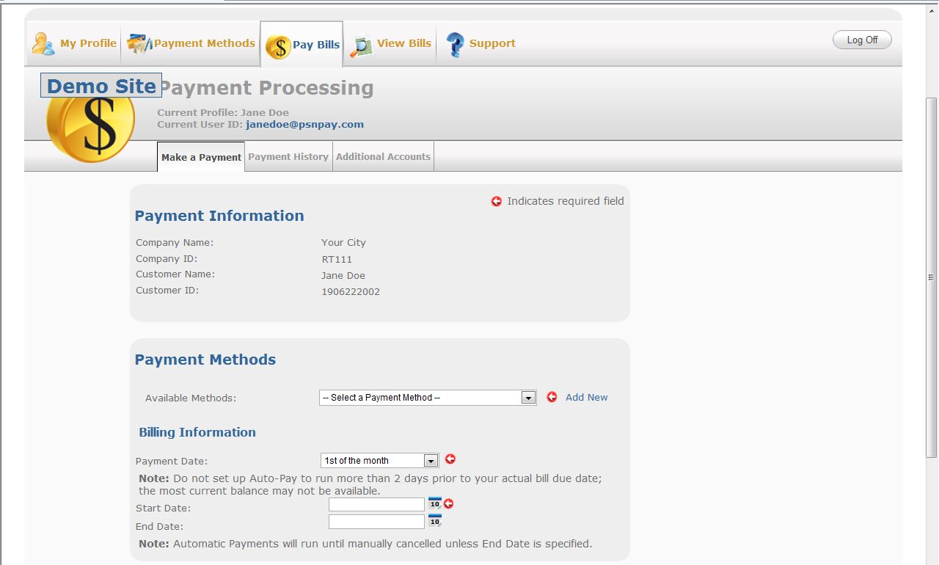
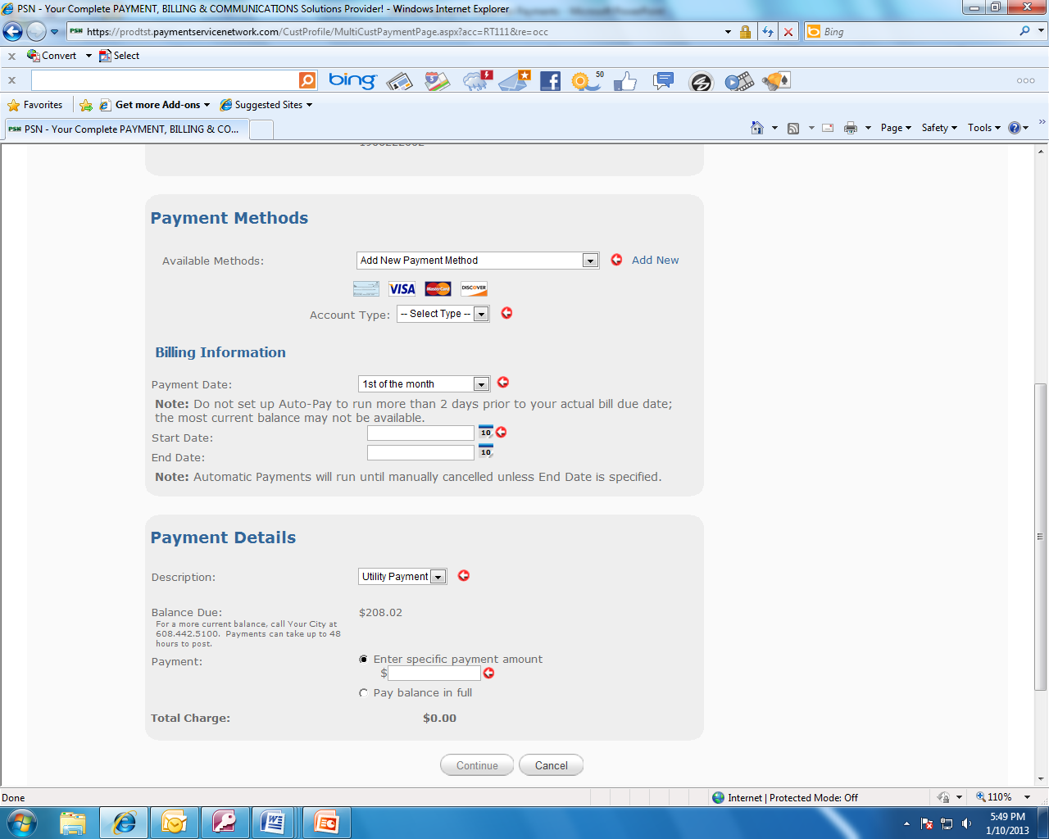
Online payments
Setting up Auto-Pay
  STEP 3.
  Set up payment information.
Smart display: Customer doesn’t need to do anything in this section
Customer adds a new payment method or selects one they have previously set up.
Select a day of the month to run the payment
Click on the calendar to select the first payment date. It is optional as to whether they put in an end date
The current balance due will display. They can select to specify a payment amount or simply check the box to pay the balance in full for each bill

Slide 16
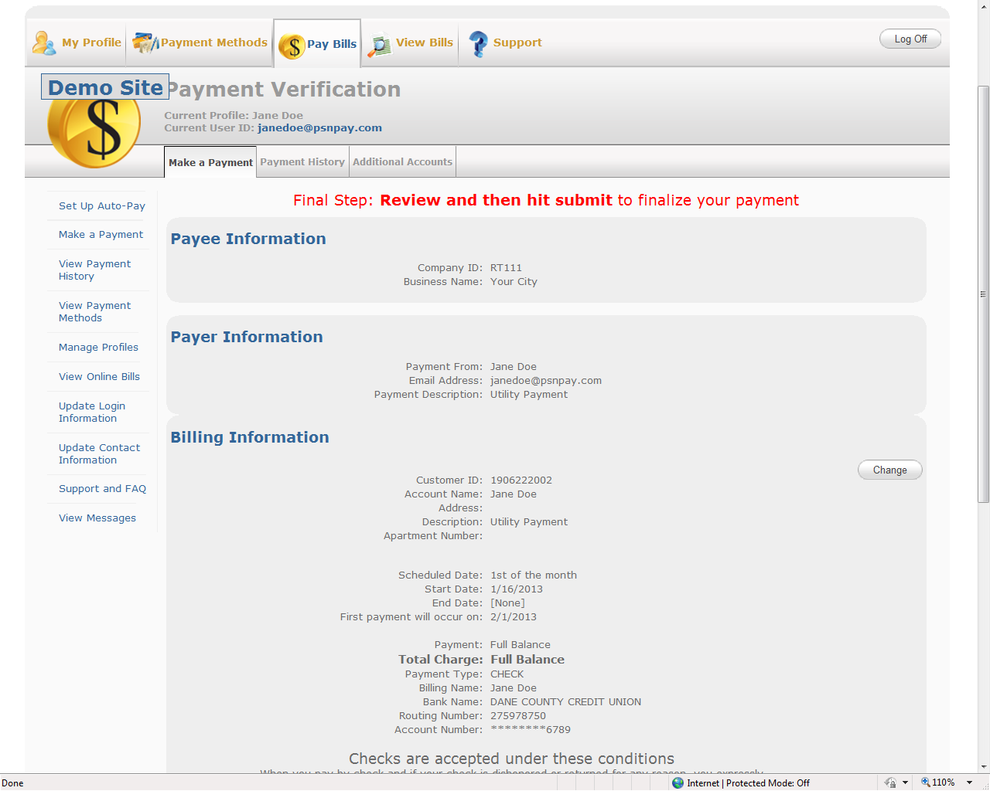
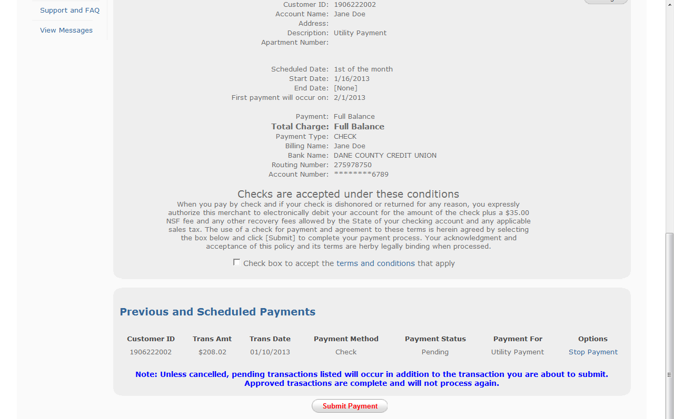
Online payments
Setting up Auto-Pay
  STEP 4.
  Customer verifies all
  of the information and submits payment.
To make sure an Auto-Payment is not duplicating an already scheduled one-time payment, we display scheduled payments which can be stopped.

Slide 17
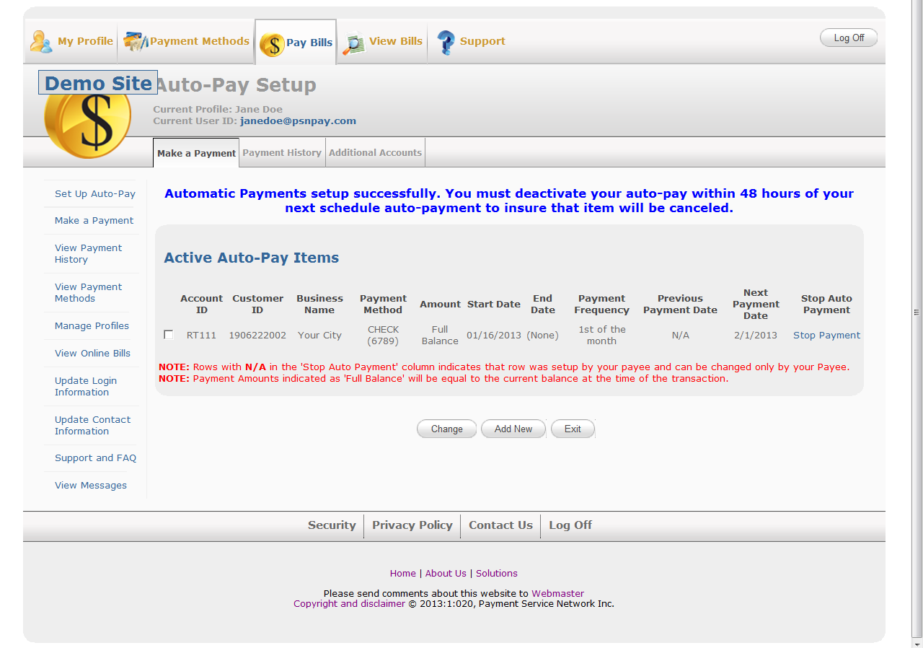
Online payments
Setting up Auto-Pay
  Verification that
  Auto-Pay has been
  set up correctly

Slide 18
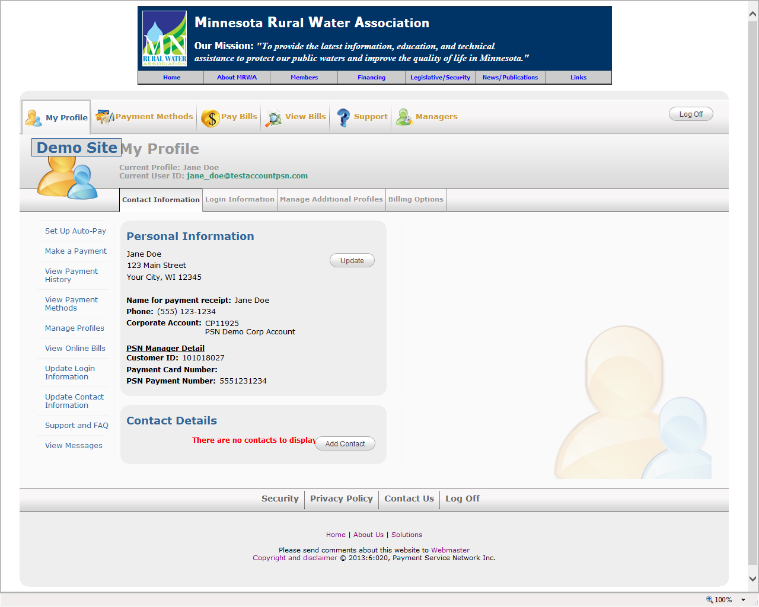
Customer Profile
  This is where your customers manage their PSN accounts. Four tabs allow for:
  Updating contact info
  Changing login info
  Grouping accounts (for those who pay more than one bill)
  Opting out of paper bills (or opting back into paper bills)

Slide 19
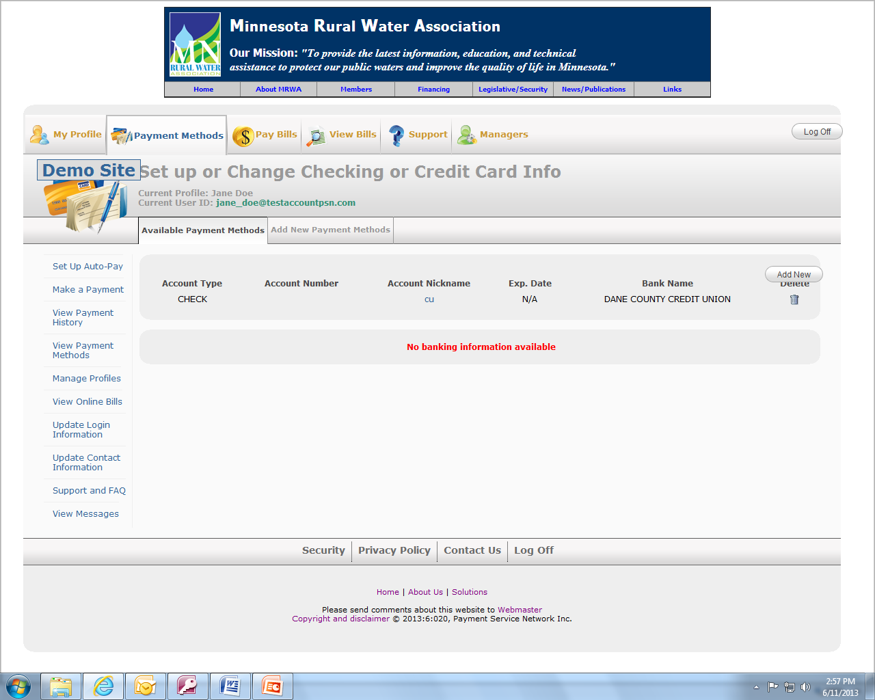
Managing Payment Methods
  This is where your customers manage their payment methods:
  Add new checking, savings, credit card (as applicable)
  Delete accounts
  Change account numbers

Slide 20
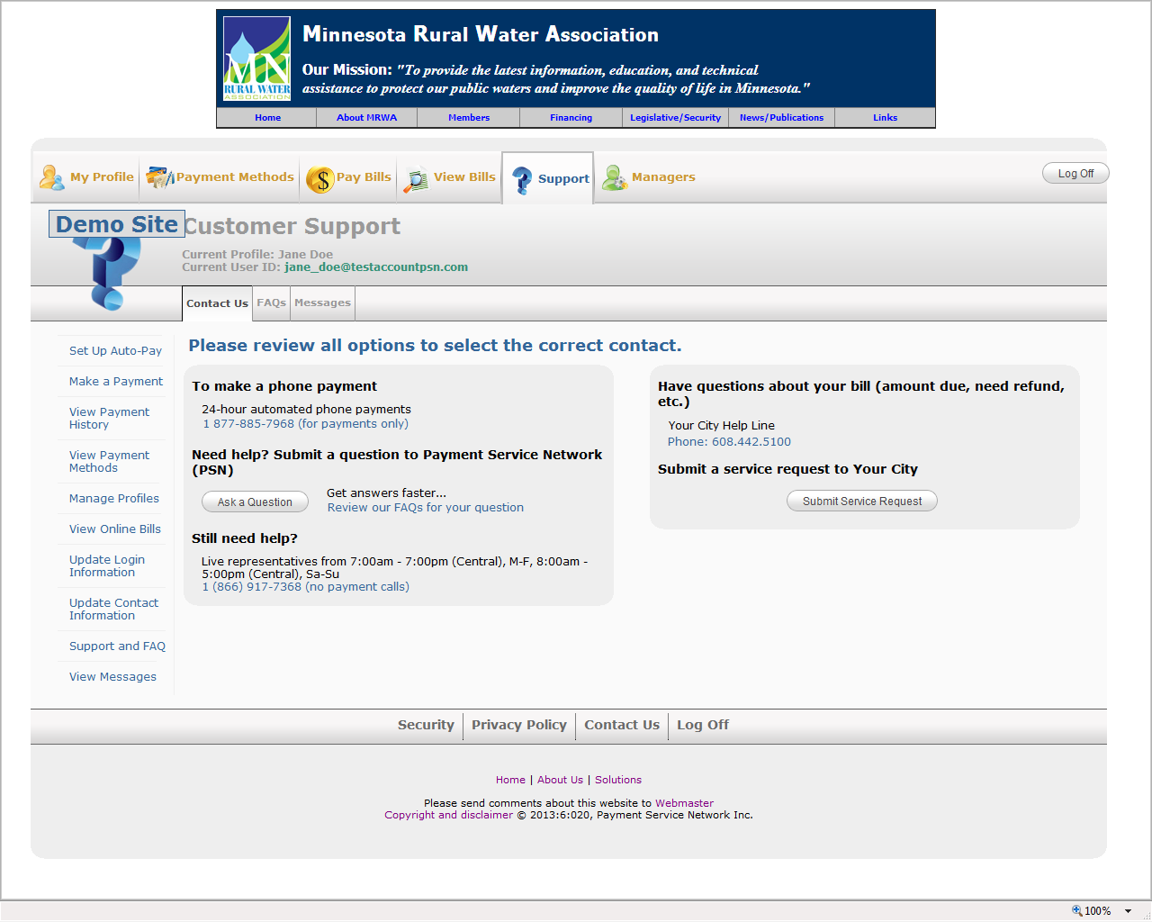
Support for your customers
  We support your customers:
  Number for phone payments
  Submit a ticket to PSN
  View FAQs
  Number for live PSN operators
  Submit a ticket to you

Slide 21

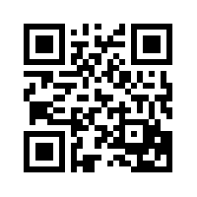
Smart Phone & Tablet Payments
  Any customer who has an iPhone®, iPad® or Android™ phone or tablet will be able to download the free “PSN Payments” app:
  Scan the QR code (which should be on your website and your marketing pieces)
  Download “PSN Payments” for the App Store® or Google Play™.
  PSN Payments

Slide 22
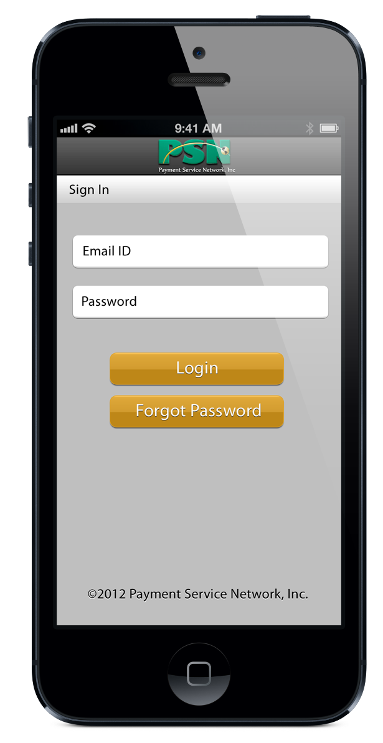
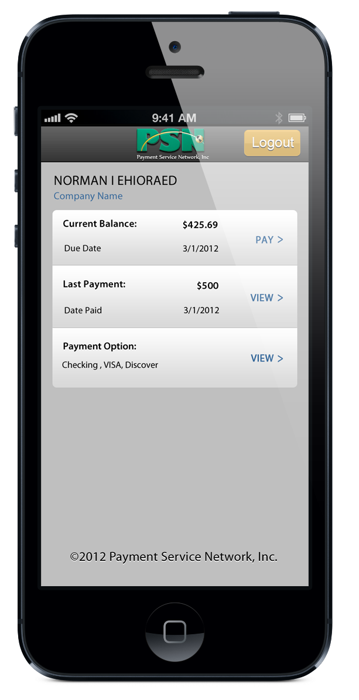
Smart Phone & Tablet Payments
  IMPORTANT: Before using the App, your customer should go online to set up his/her PSN Customer Profile. They can do this on their mobile device but it is easier on a regular computer.
  Customer logs in with PSN credentials.
  Customer chooses to:
  Pay
  View Payments Made
  Change payment method (checking, credit card)

Slide 23
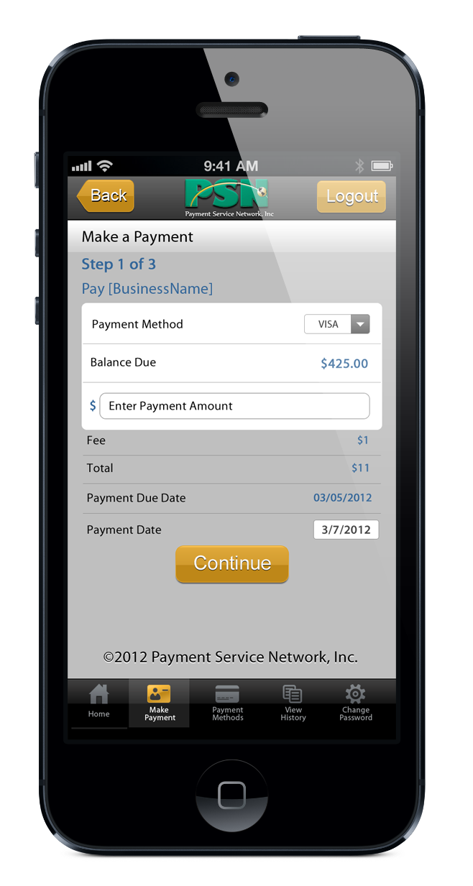
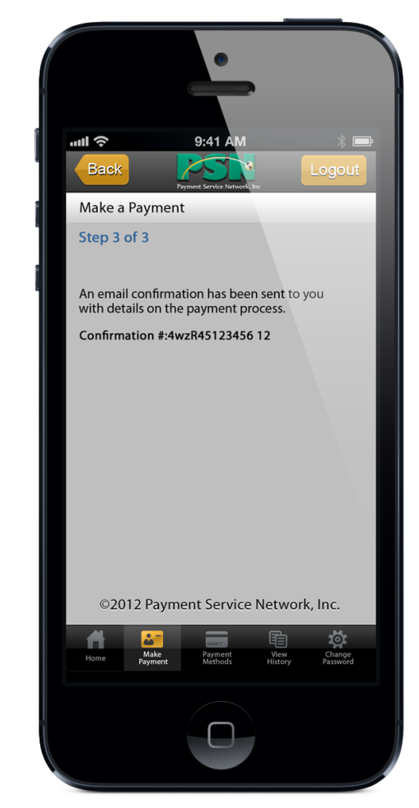
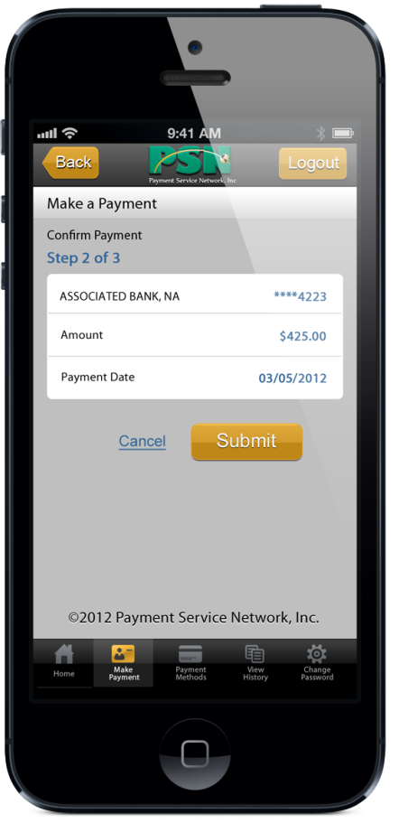
Smart Phone & Tablet Payments
  IMPORTANT: Before using the App, your customer should go online to set up his/her PSN Customer Profile. They can do this on their mobile device but it is easier on a regular computer.
  STEP 1.
  Customer selects payment method and amount and then clicks Continue.
  STEP 3.
  Customer receives confirmation.
  STEP 2.
  Customer confirms info and clicks Submit.

Slide 24


Phone payments (IVR)
  Customer will call 877-885-7968
  They can opt for English or Spanish
  The first time they call, they will validate themselves. Then any future calls are a quick process.
877-885-7968

Slide 25
Phone payments (IVR)
Validation process…
1
2
Customer calls & selects English or Spanish
PSN system “looks” for phone number & knows if new user
PSN asks customer to enter utility account number and ZIP
PSN attempts to authenticate to your customer database
No Match
Live PSN CSR
Match
3
4
5
6
PSN asks, “Are you paying [your company name]?”
PSN asks, “Are you [customer name]?”
PSN asks customer to input PSN id—use number calling from or other phone number
PSN prompts for banking/ credit card info
Registered & can make payment
Your customer can reach a PSN operator at anytime

Slide 26
Phone payments (IVR)
Making a Payment on Subsequent Calls
1
2
Customer calls (preferably from their registered phone number)
PSN “looks” for the phone number & identifies it
PSN asks are you “customer name”
Live PSN CSR
No Match
Match
3
4
5
PSN asks for last four digits of checking/
credit card number or asks to set up new payment method
PSN asks for payment amount
PSN states payment info and asks customer to confirm
PSN provides confirmation number
Your customer can reach a PSN operator at anytime

Slide 27
Thank You
Contact your Service Account Manager
for any additional information.
Hours: 8am-5pm CST
Voice: 866.917.7368
Email: CustomerService@PaymentServiceNetwork.com

