Slide 1
Flood Investigation -
Industrial Park Ave
Village of Hortonville, WI

Slide 2
Flood Investigation - Industrial Park Ave
Village of Hortonville
Presentation Agenda
Scope of Project
Watershed Characteristics
Flood Inundation Mapping
Findings & Considerations

Slide 3
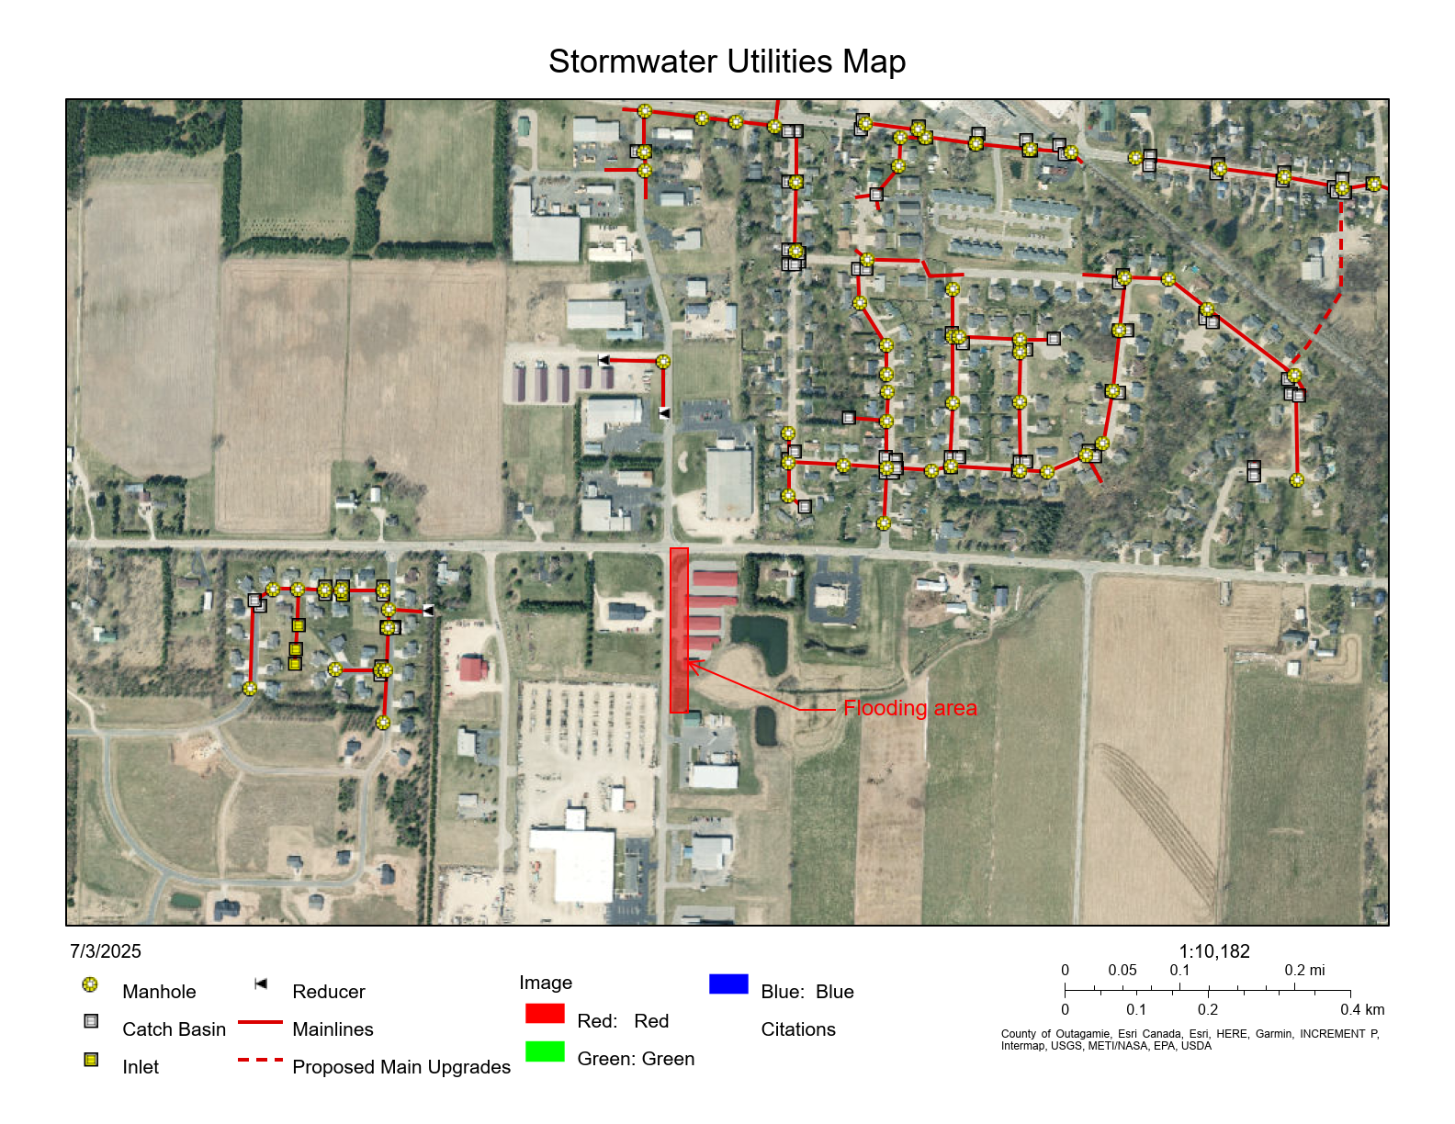
Flood Investigation - Industrial Park Ave
Scope of Work

Slide 4
Flood Investigation - Industrial Park Ave
Scope of Work
Field Reconnaissance
Hydrologic Model Construction
Hydraulic Model Construction
Complete Alternatives Analysis
Report

Slide 5
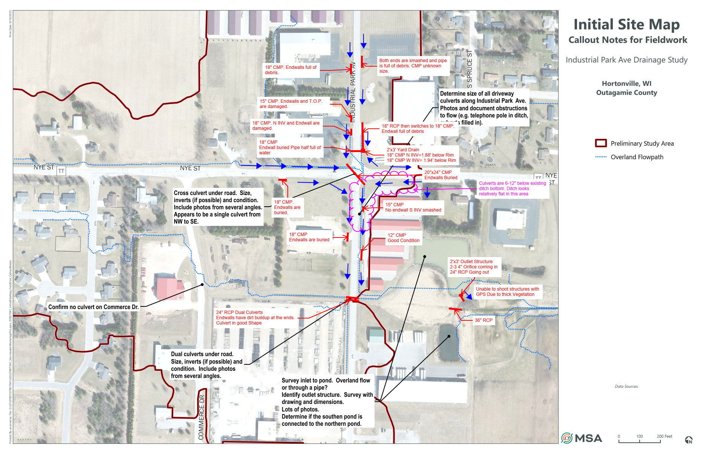
Flood Investigation - Industrial Park Ave
Visual Inspections

Slide 6
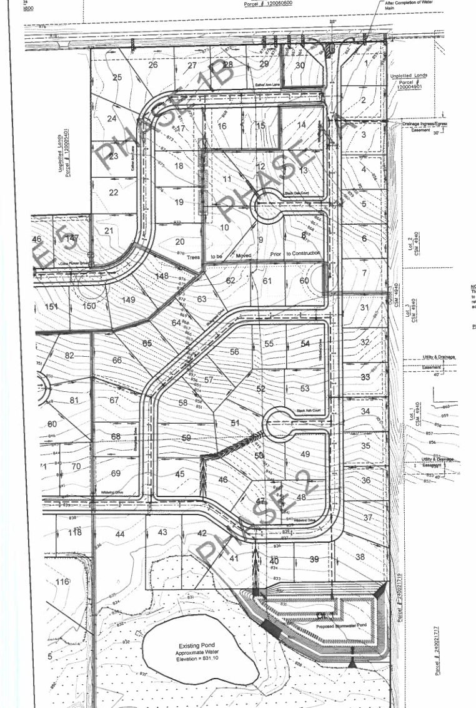
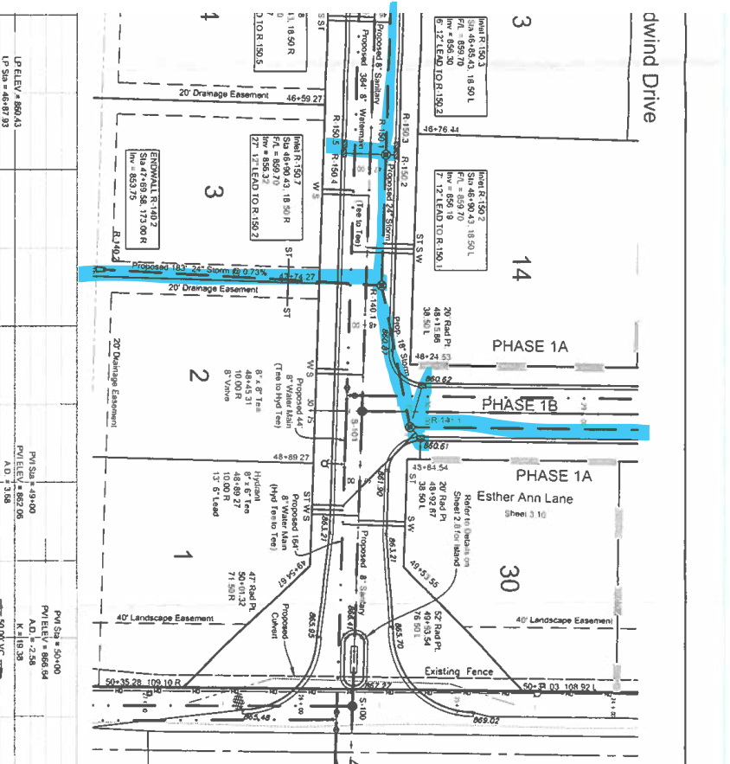
Flood Investigation - Industrial Park Ave
Inspections Supplemented with Plan Data Where Available
Wildwind Village Subdivision

Slide 7
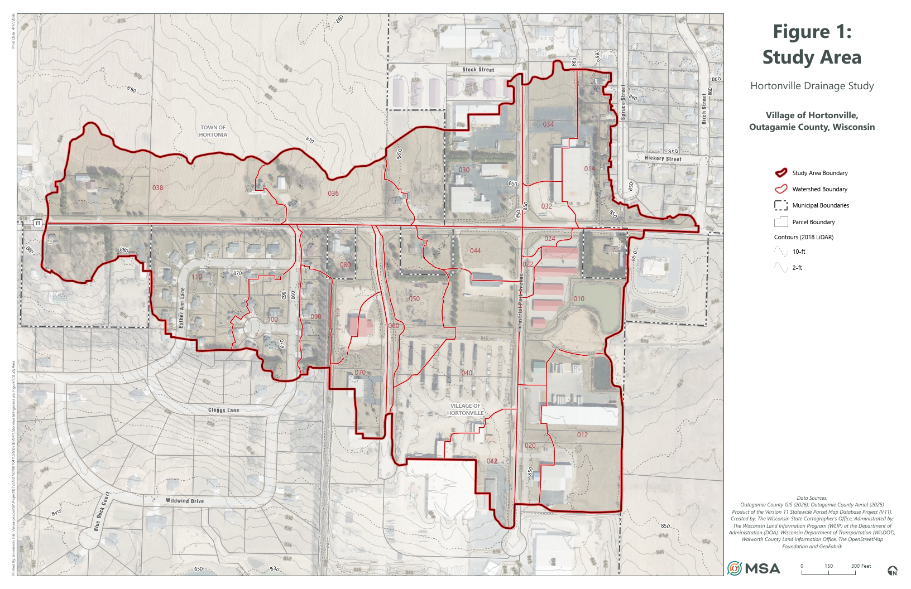
Flood Investigation - Industrial Park Ave
Watershed Characteristics
Total Area = 110.3 acres

Slide 8
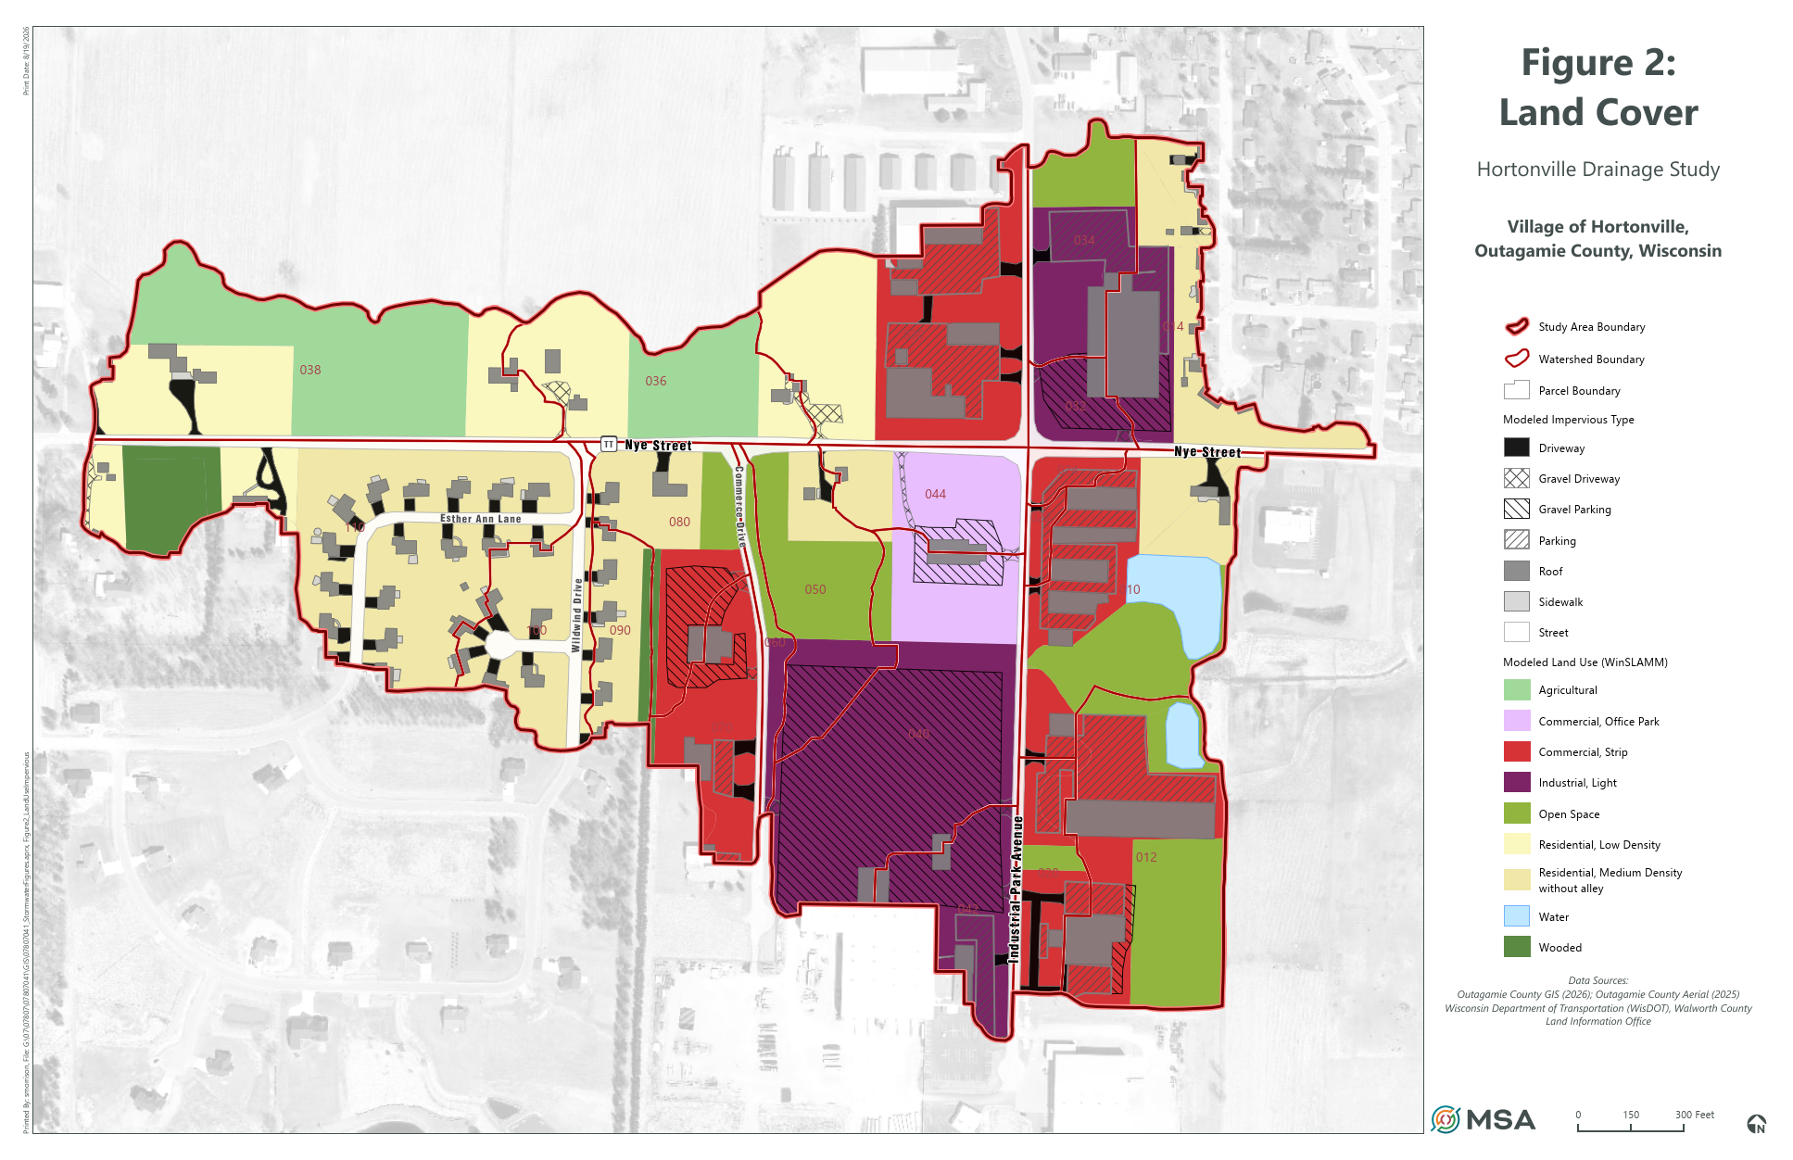
Flood Investigation - Industrial Park Ave
Watershed Characteristics
 | Impervious Area (ac) | Fractional of Watershed
Connected | 25.6 | 23%
Unconnected | 14.8 | 13%
Total | 40

Slide 9
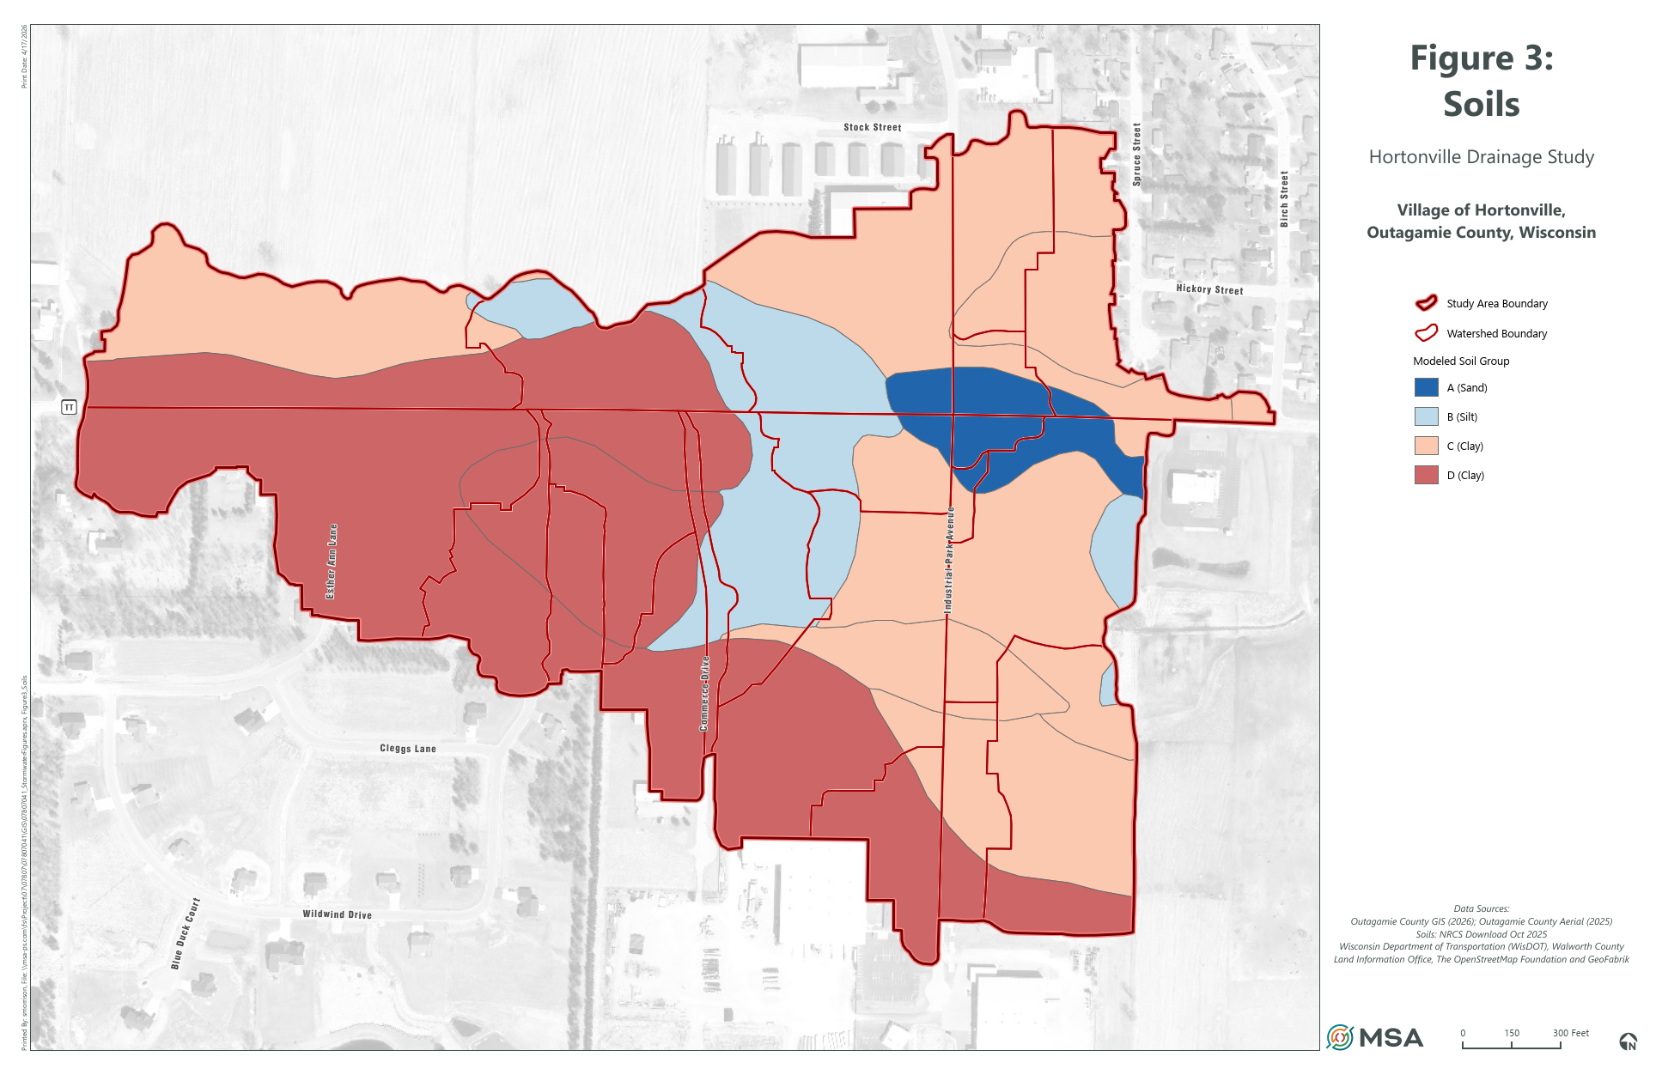
Flood Investigation - Industrial Park Ave
Watershed Characteristics
Hydrologic Soil Group | General Texture Class | Fractional Area
A | Sand | 4%
B | Silt | 12%
C | Clay | 41%
D |  | 43%

Slide 10
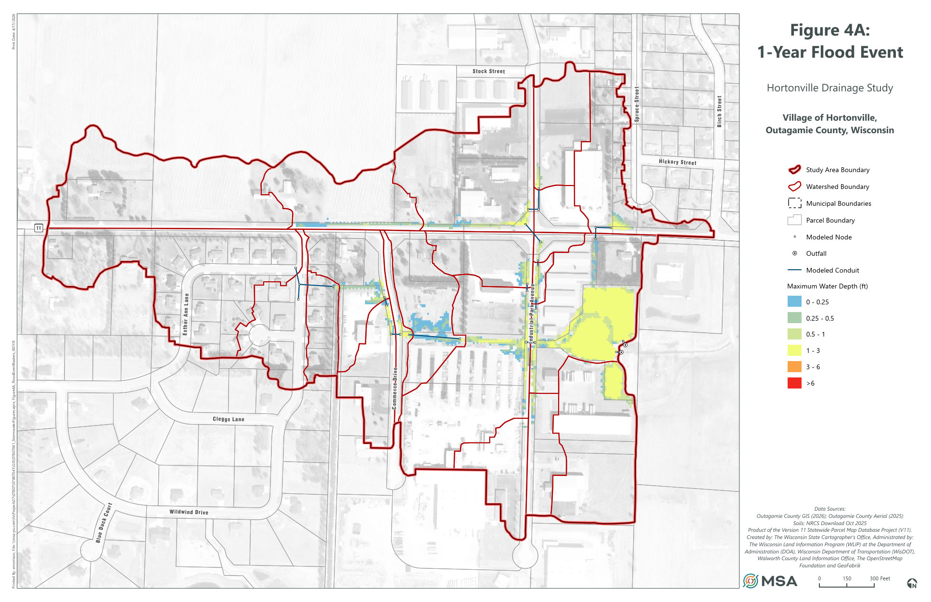
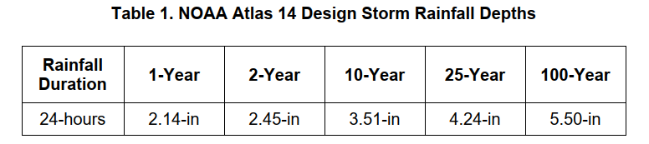
Flood Investigation - Industrial Park Ave
Flood Inundation Mapping

Slide 11
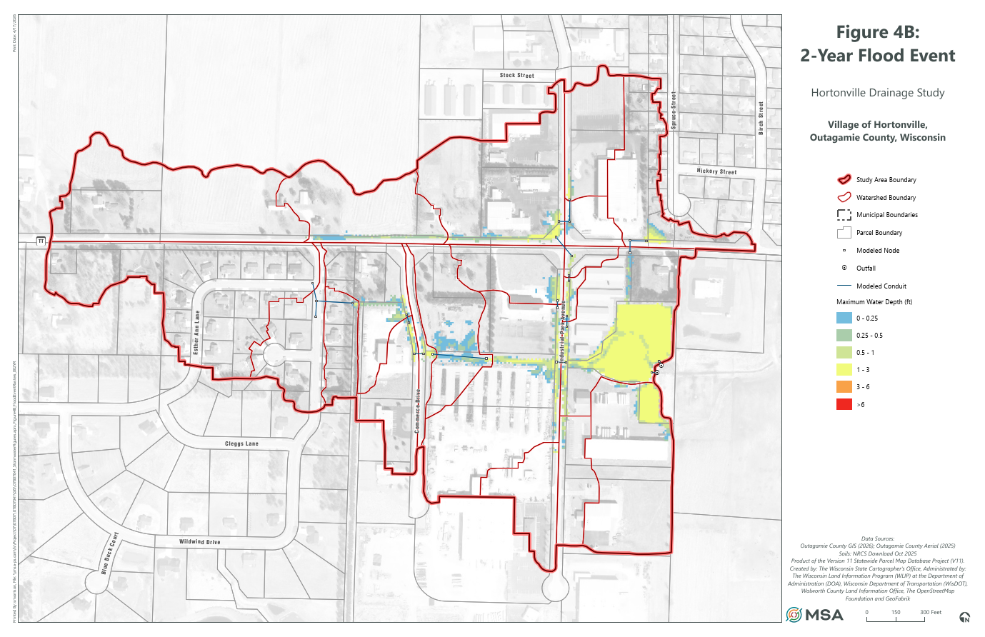
Flood Investigation - Industrial Park Ave
Flood Inundation Mapping

Slide 12

Flood Investigation - Industrial Park Ave
Flood Inundation Mapping

Slide 13

Flood Investigation - Industrial Park Ave
Flood Inundation Mapping

Slide 14

Flood Investigation - Industrial Park Ave
Flood Inundation Mapping

Slide 15
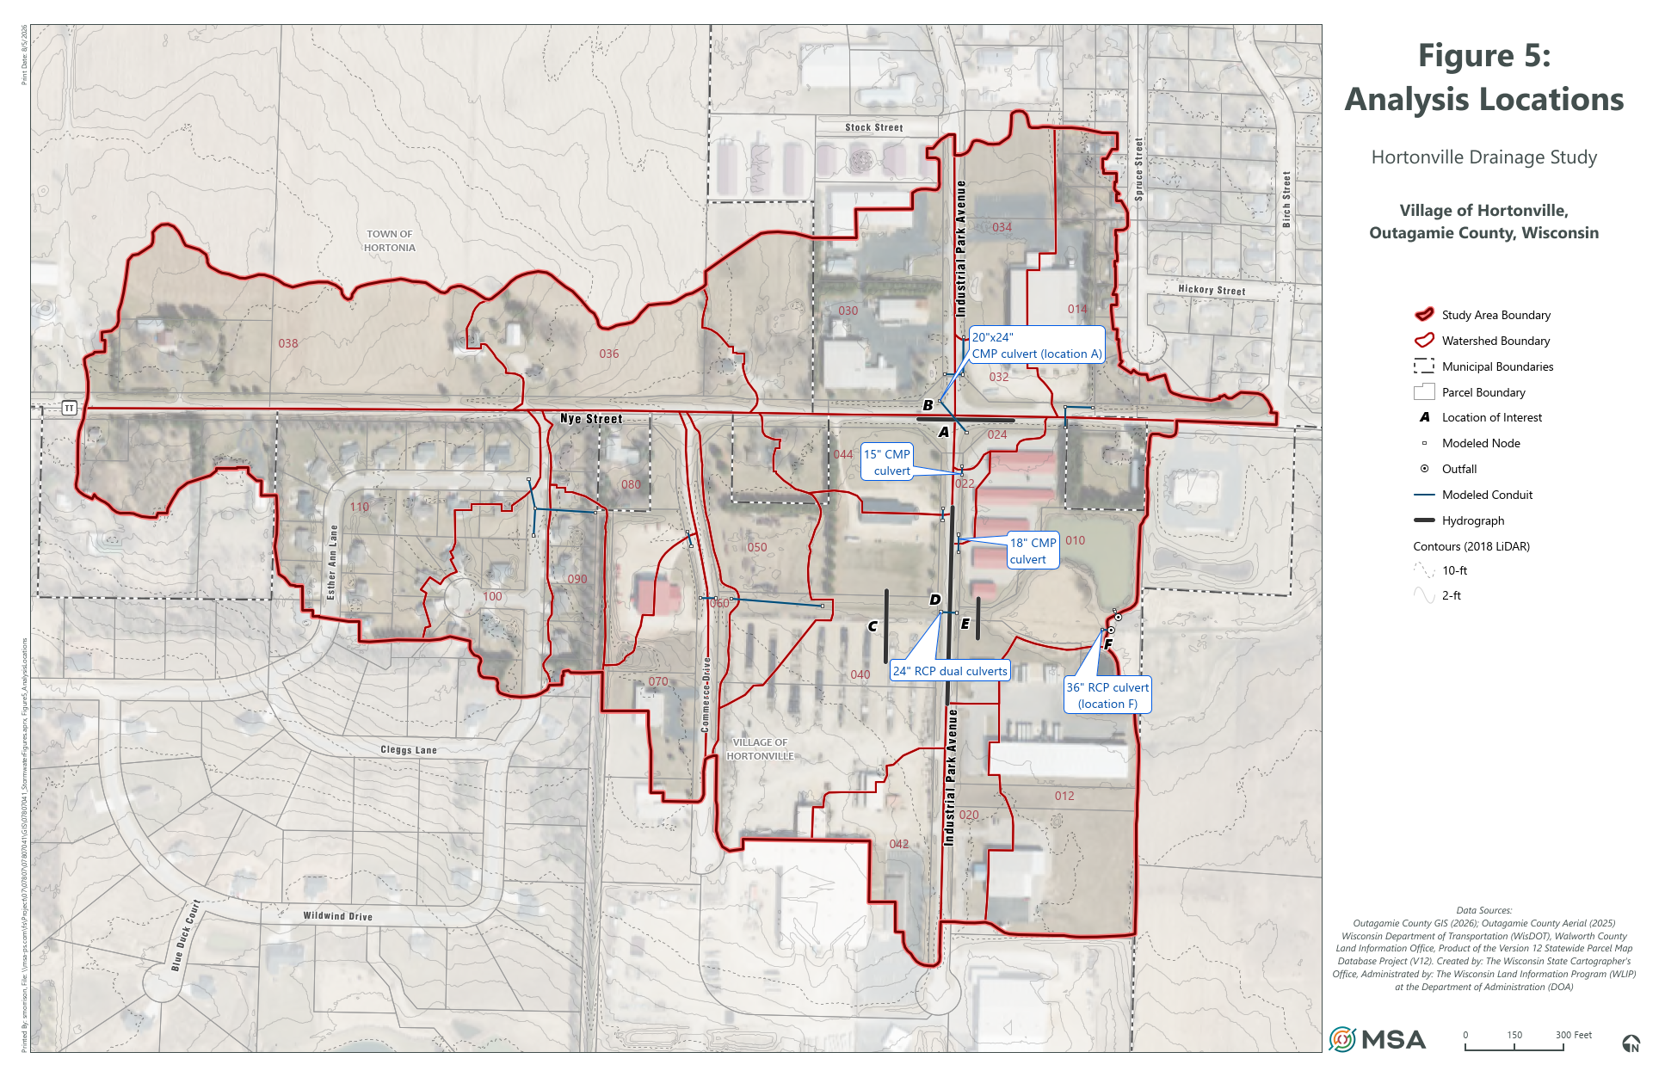
Flood Investigation - Industrial Park Ave
Findings/Recommendations

Slide 16
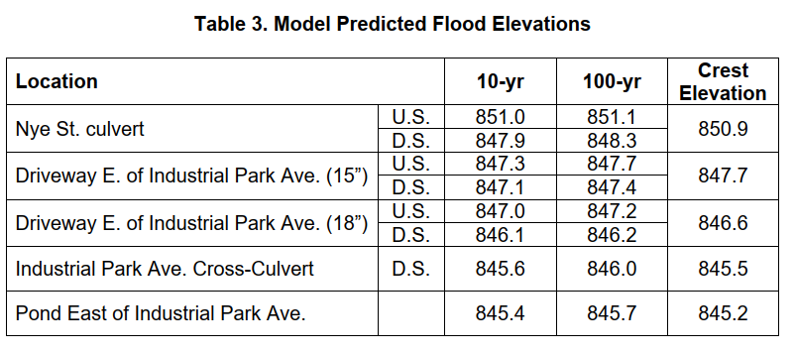
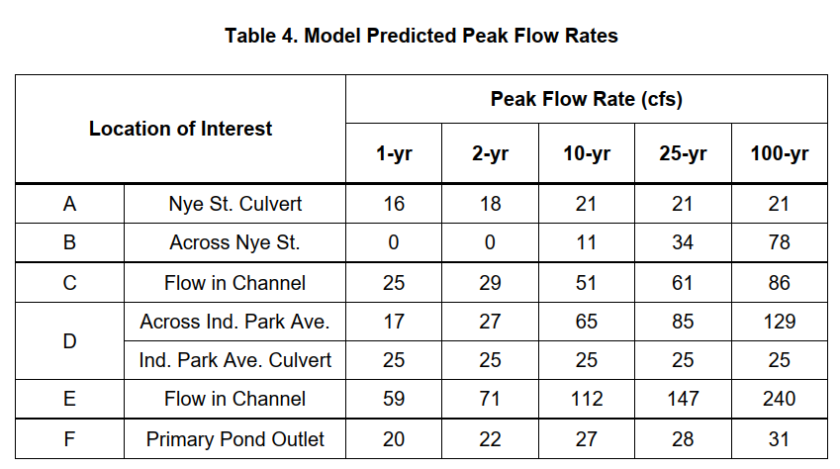
Flood Investigation - Industrial Park Ave
Findings – Culvert Level-of-Service Analysis

Slide 17
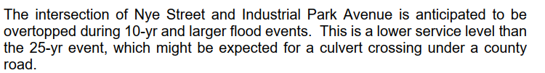
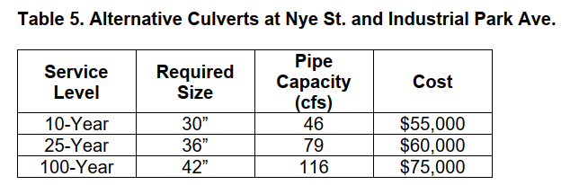
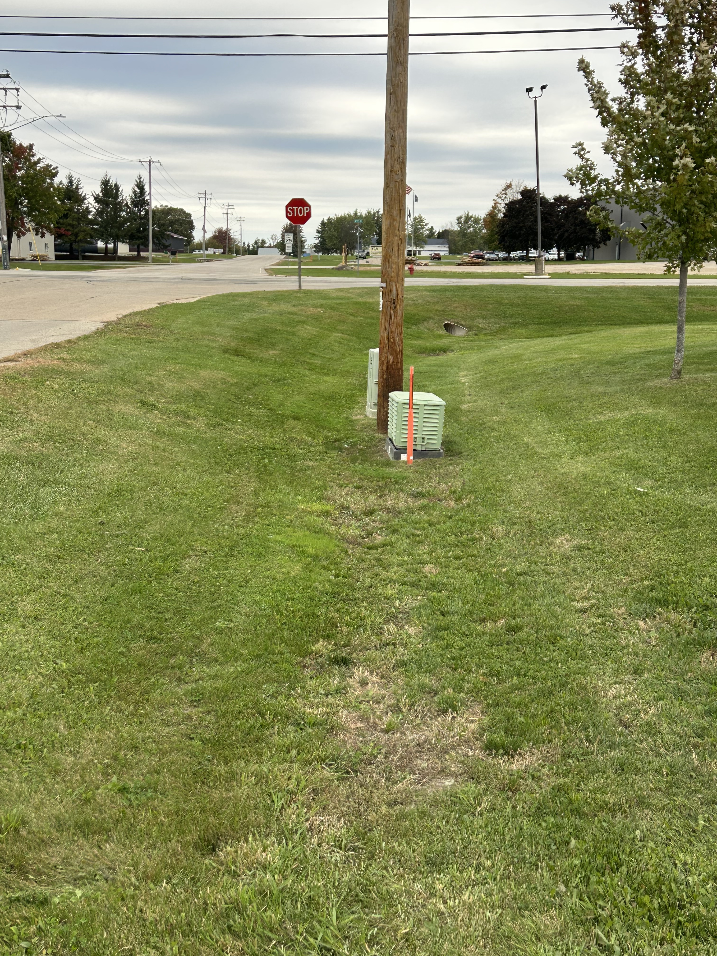
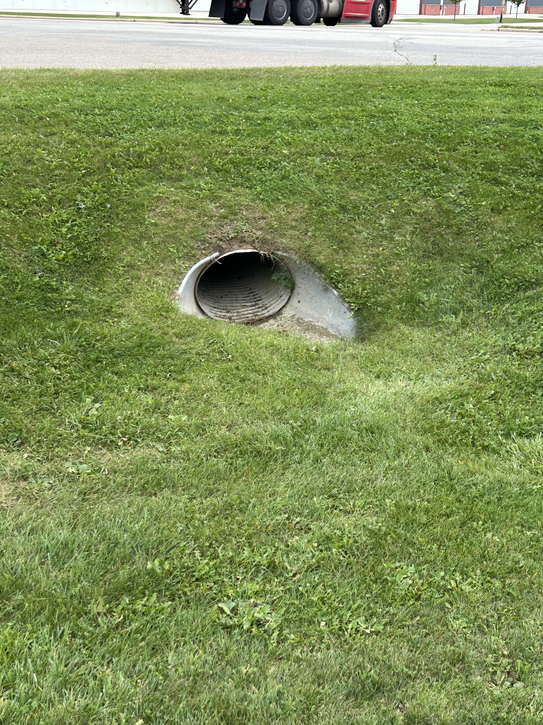
Flood Investigation - Industrial Park Ave
Findings – Nye Street

Slide 18
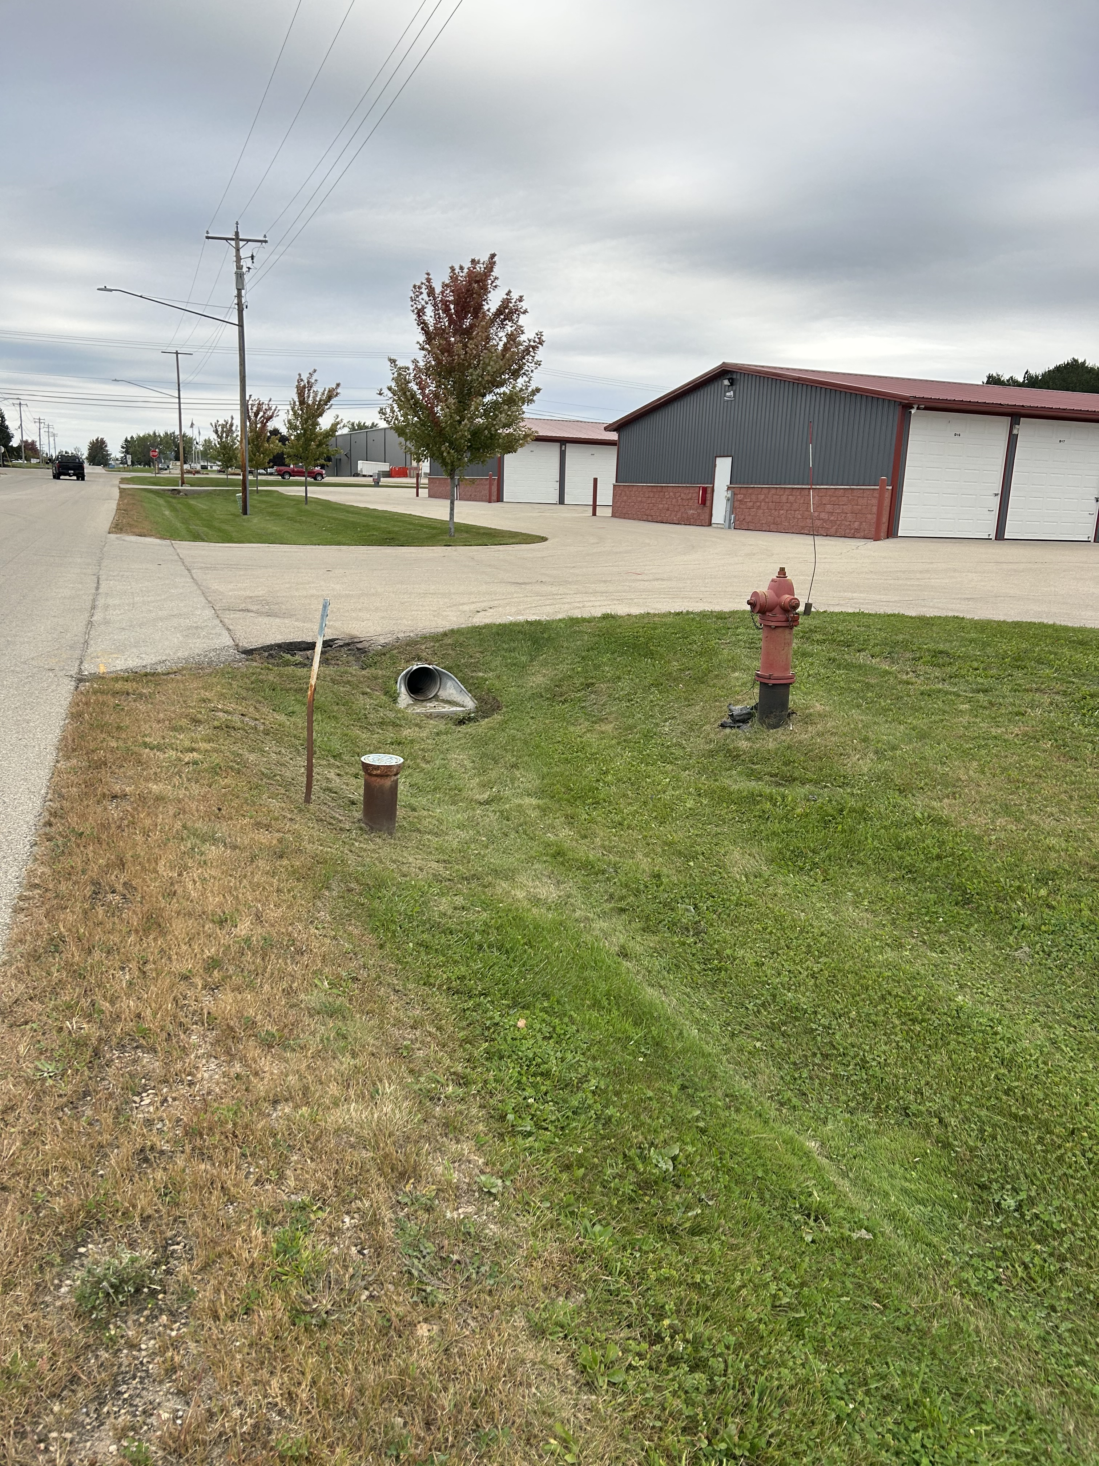
Flood Investigation - Industrial Park Ave
Findings – Industrial Park Avenue Driveway Culverts
Improvements to driveway culverts should match any improvements at Nye Street; however, cover issues may require dual elliptical pipes.

Slide 19
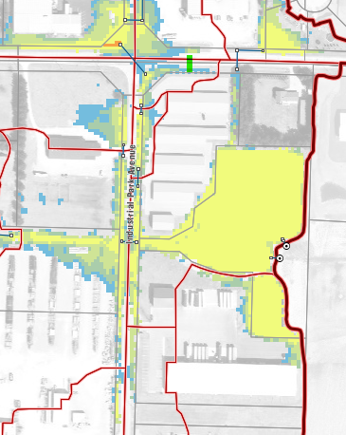
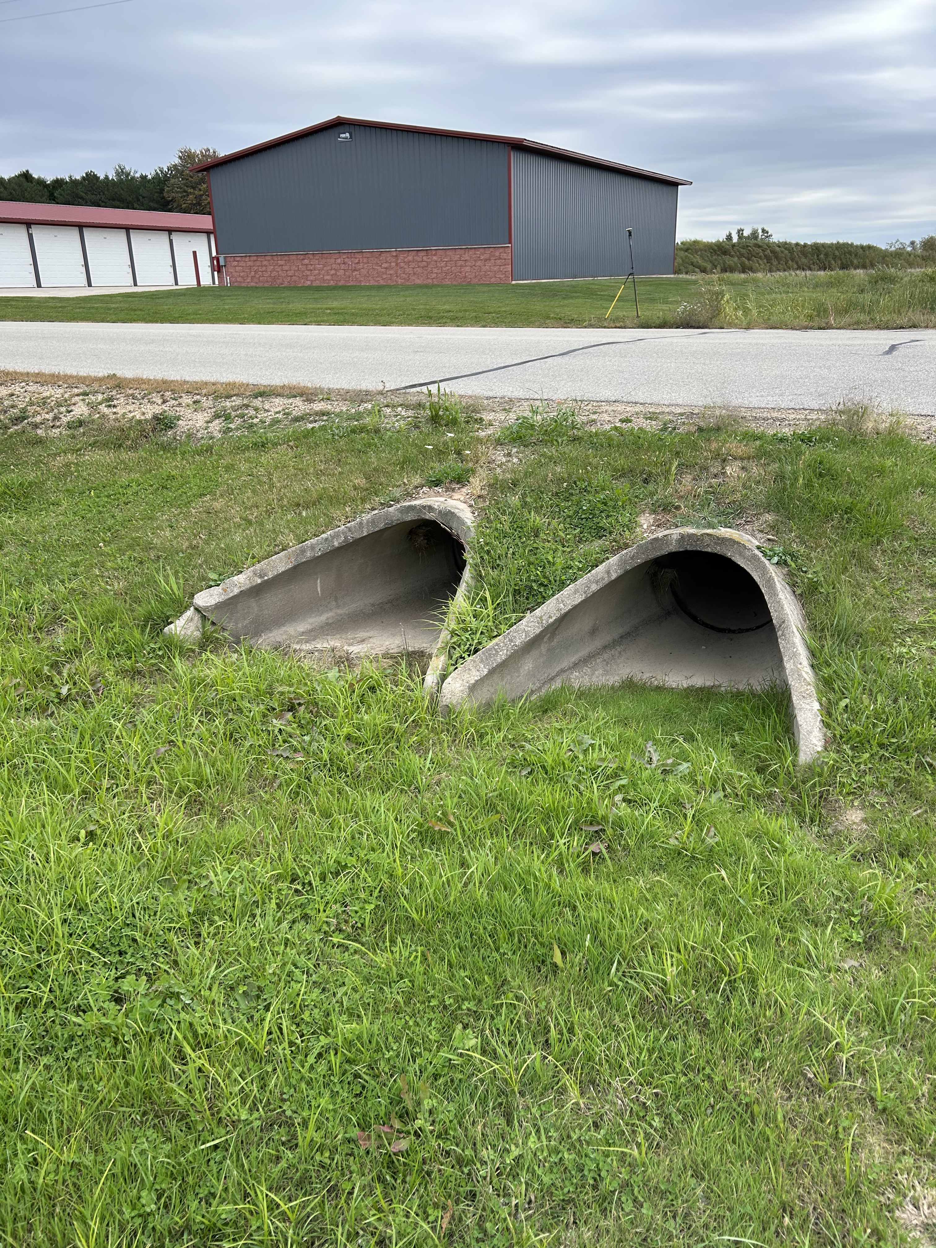
Flood Investigation - Industrial Park Ave
Findings – Industrial Park Avenue Culverts
Very little cover over existing dual 24” culverts
Backwater effects from the downstream pond reduce effective capacity
Replacement with dual 36” eq HERCs
  ~$70,000
  ~ 1-yr level of service
Detention in NW corner a possibility.

Slide 20
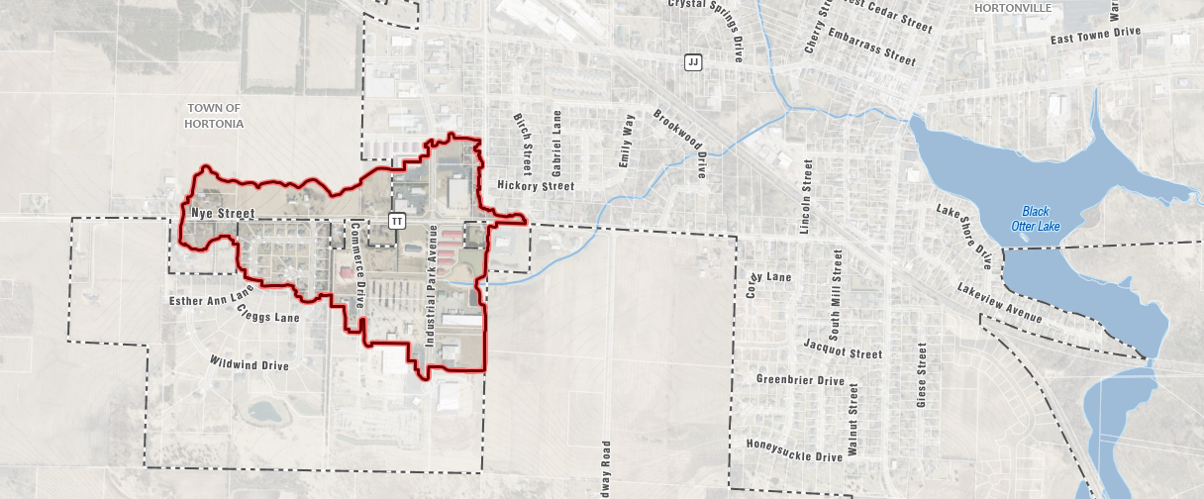
Flood Investigation - Industrial Park Ave
Findings – Industrial Park Avenue Culverts
Unconventionally designed pond
  Normal water level ~ 843.0
  Controlled by invert 36-inch outlet.
  Berm crest ~ 845.2, 80% of pipe height.
  2-yr peak flood elevation in pond = 845.2.
    Floodwaters within 0.3 feet of flooding Industrial Park Avenue
    Floodwater back up to rough midpoint between driveway culverts
    Very little detention for larger storms.
Increasing berm height to detain more water will create additional back-ups
Increasing outlet to discharge more water increase risk of downstream flooding.

Slide 21
Flood Investigation -
Industrial Park Ave
Village of Hortonville, WI

