Slide 1
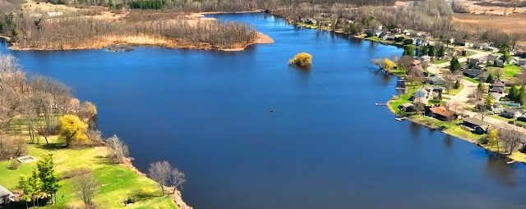
BOLD 2026 Annual Meeting
Sean Kuske- Chairman
Judy Williams- Treasurer
Colton Glocke- Secretary
Dalton Davis- Village Rep
Dan Nejedlo- County Rep
Aaron Steber- Trustee
Jared Dorn- Trustee

Slide 2
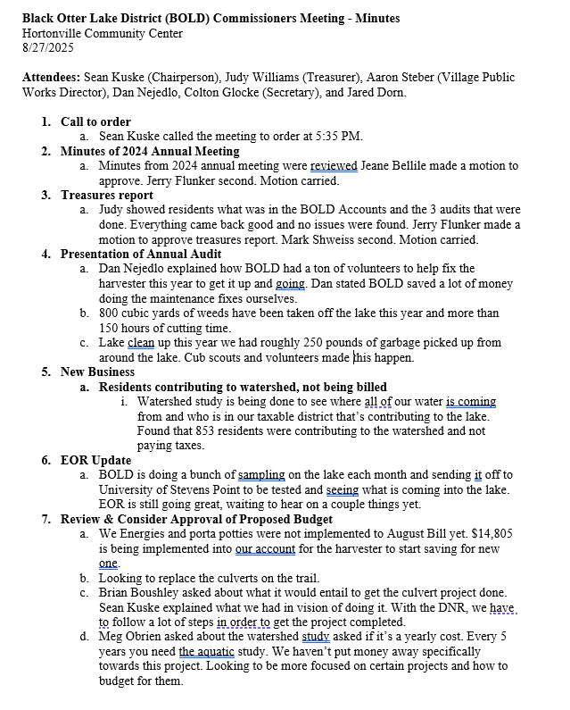
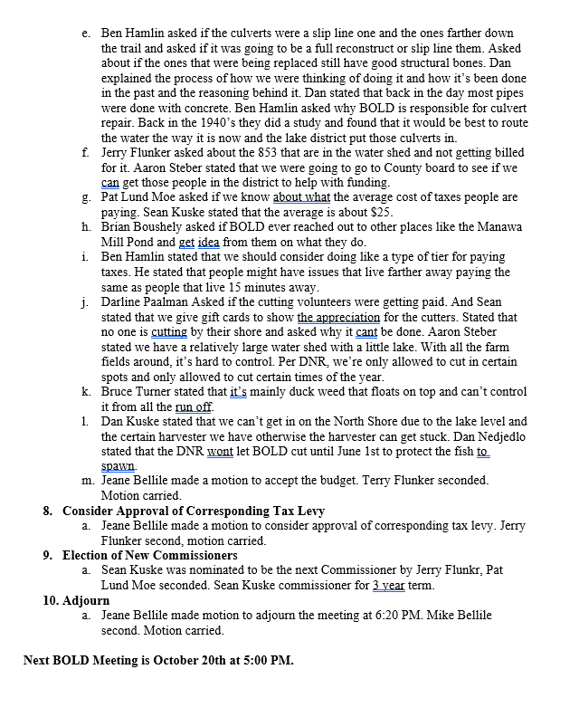
Minutes of 2025 Meeting

Slide 3


Slide 4
2026 Accomplishments
Harvester/Equipment Maintenance
  Appx 155 hours, 130 truck loads equaling 900 cubic yards worth of weeds taken out of lake
Lake cleanup
  49 Volunteers, 33 bags of trash, 250 Lbs. of garbage total
EOR watershed study

Slide 5
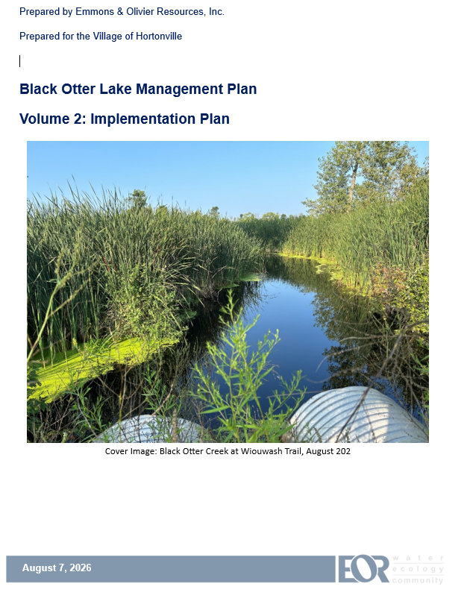
New Business: Emmons & Oliver Resources (EOR)

Slide 6
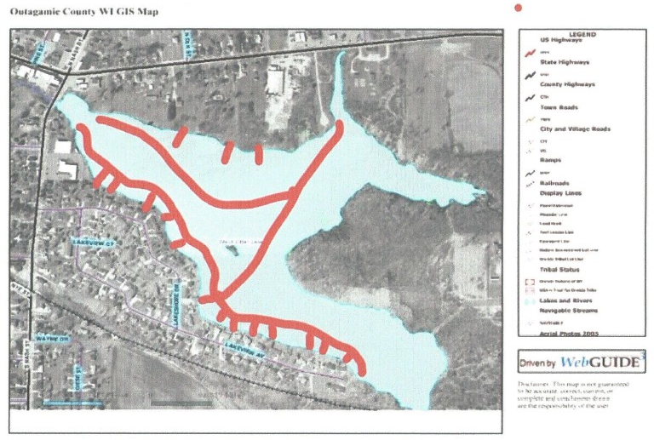
New Harvester Discussion
In 2018, BOLD invested in an Eco Cutter aquatic plant harvester, which conducts summer harvesting in boat lanes, fishing areas, and shore areas.
In 2023, BOLD developed the current waterway management harvesting operation plan which accompanied submittal of a mechanical aquatic plant management permit application to WDNR.

Slide 7
New Harvester Discussion
Current harvesting permit is being implemented and is valid through October 2027.
Grant used to purchase harvester is up April of 2028, if harvester is sold before then would have to return 50% of sale price to DNR.
Current price of a new harvester approximately $150,000 - $300,000
Recreational Boating Facility Grant Program
  Given through the Wisconsin Waterway Commission
  50% Cost share on new harvesting equipment
  Not currently funded for 2027
Board of Commissioners of Public Lands State Trust Fund Loan Program
  Helps finance equipment purchases (currently ~6%)
  Same rate offered by Loan Program locally through Wolf River Community Bank

Slide 8
New Harvester Potential Plan
Fall of 2026 - Meet with Aquarius to review current equipment and discuss with operators what works, what doesn’t, what would be better for use on Black Otter Lake
Spring 2027- Decide on specifications of new harvester and get quote from Aquarius
Summer of 2027 – Order new harvester (10-12 month lead time), Aquarius agrees to wave down payment until receiving grant funds
Fall of 2027 – Update current waterway management harvesting operation plan and accompanied submittal of a new mechanical aquatic plant management permit application to WDNR for 2028
Spring of 2028 – Apply for 50% matching grant funds for harvester through Recreational Boating Facility Grant Program, Aquarius to complete grant paperwork for BOLD
Spring of 2028 – New permit approved for harvesting in 2028
Summer of 2028 – New Harvester delivered for 2028 harvesting
Summer of 2028 – Grant funds received and down payment on new harvester paid

Slide 9
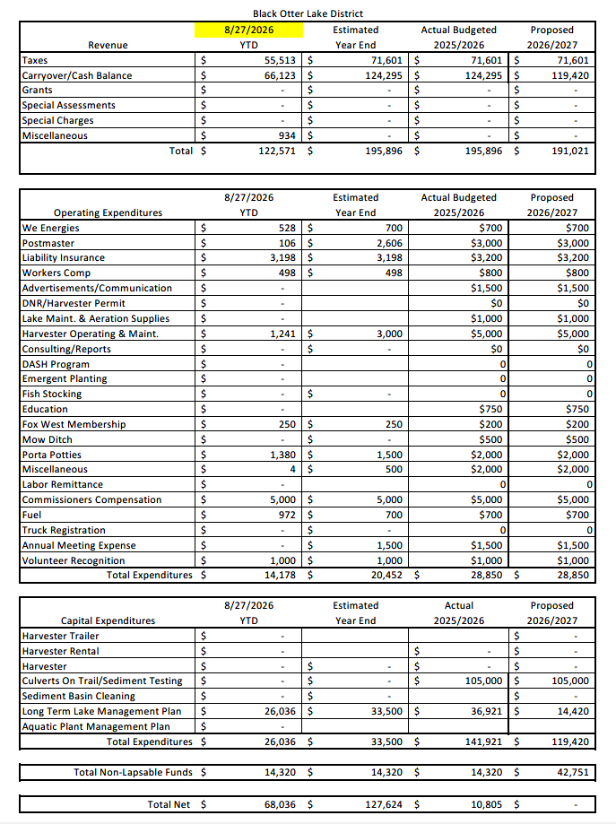
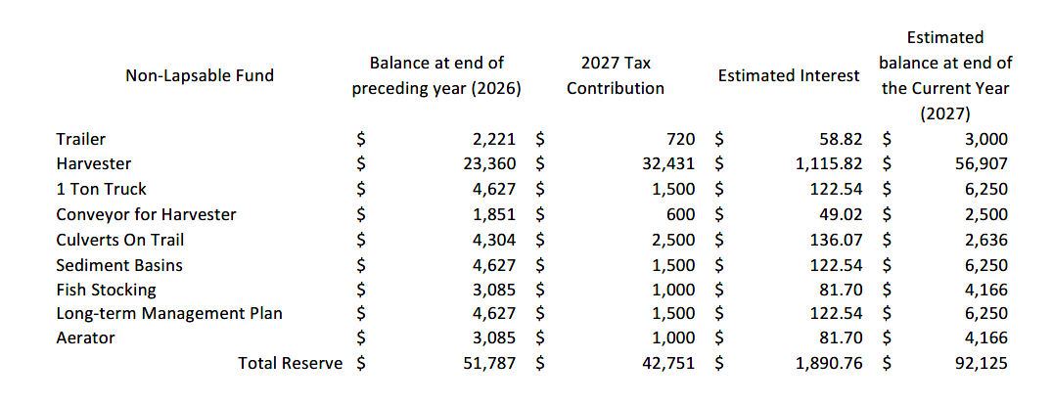
Budget

Slide 10
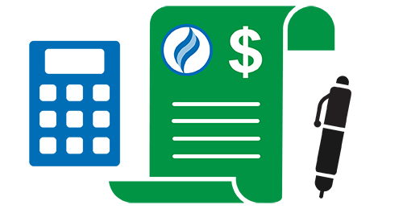
Review and Consider Approval of Proposed Budget

Slide 11

Election of Commissioners by Secret Ballot

Slide 12
Adjourn Meeting
Thank you all for coming!

